Slide 1
Il mare a scuola
classe 3 A scuola primaria A. De Gasperi

Slide 2
Presentazione del progetto
Noi bambini di San Pietro Vernotico viviamo a pochi km dal mare e trascorriamo felicemente le nostre vacanze nelle marine del nostro paese.
In questo progetto abbiamo studiato il mare da più punti di vista e lo abbiamo rappresentato con alcune immagini prodotte nel corso dell’anno.
E’ stato un modo per avvicinarci di più alle varie problematiche connesse al rapporto dell’uomo con il mare e a farci prendere coscienza di ciò che potremmo fare di buono per proteggere questo prezioso dono.

Slide 3
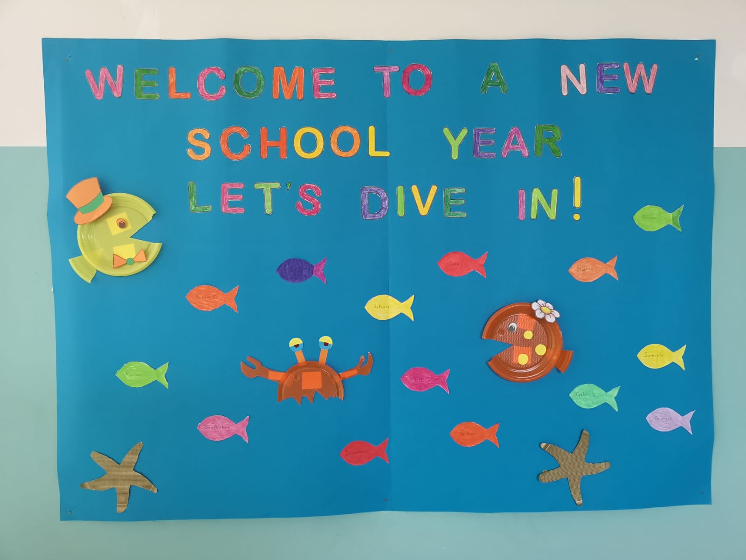

Slide 4
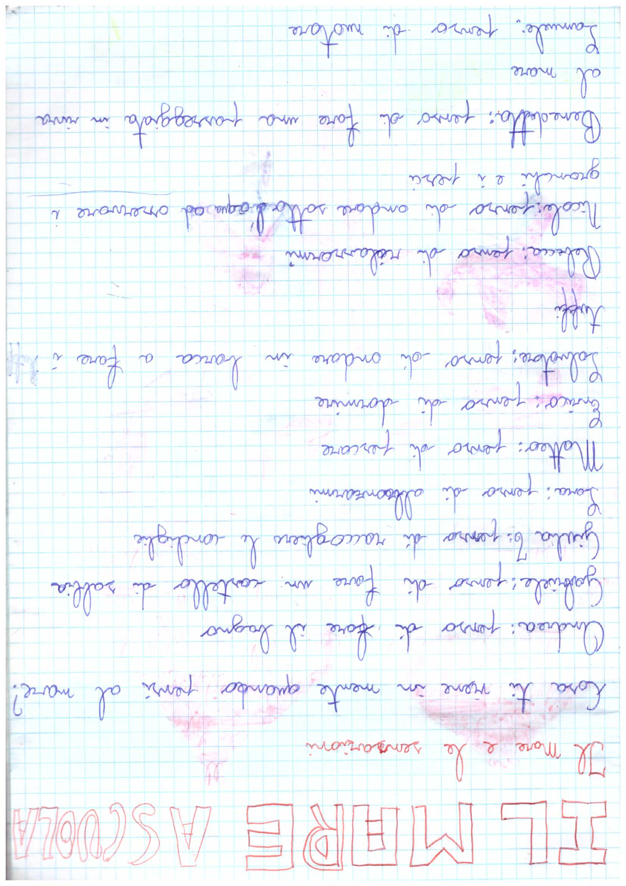
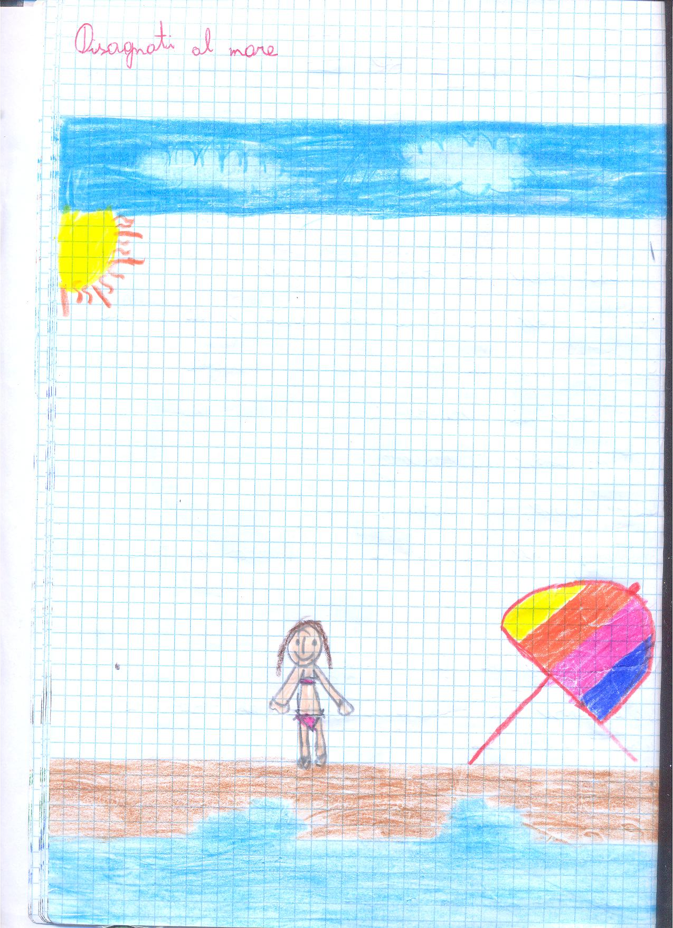

Slide 5
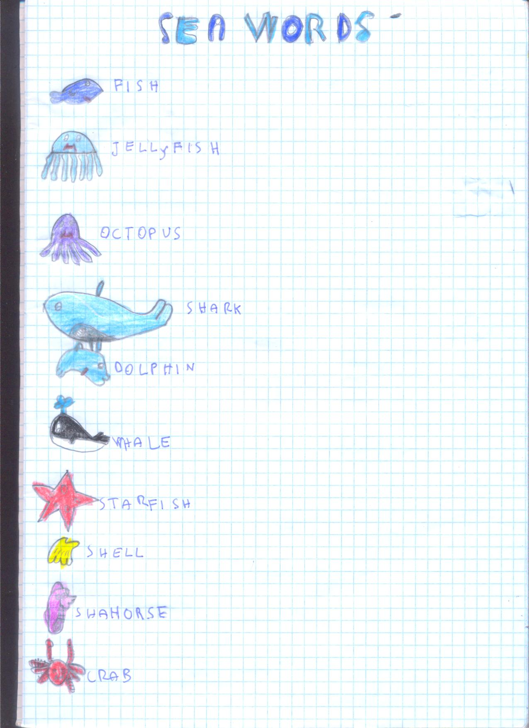

Slide 6
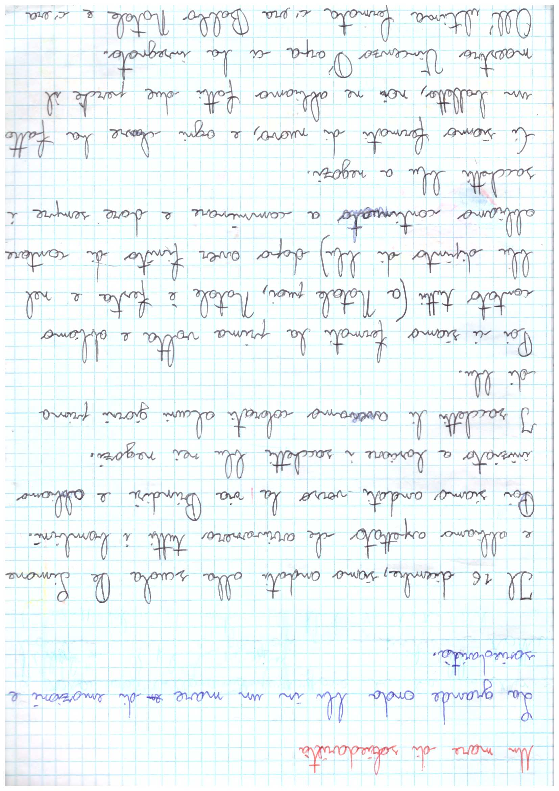
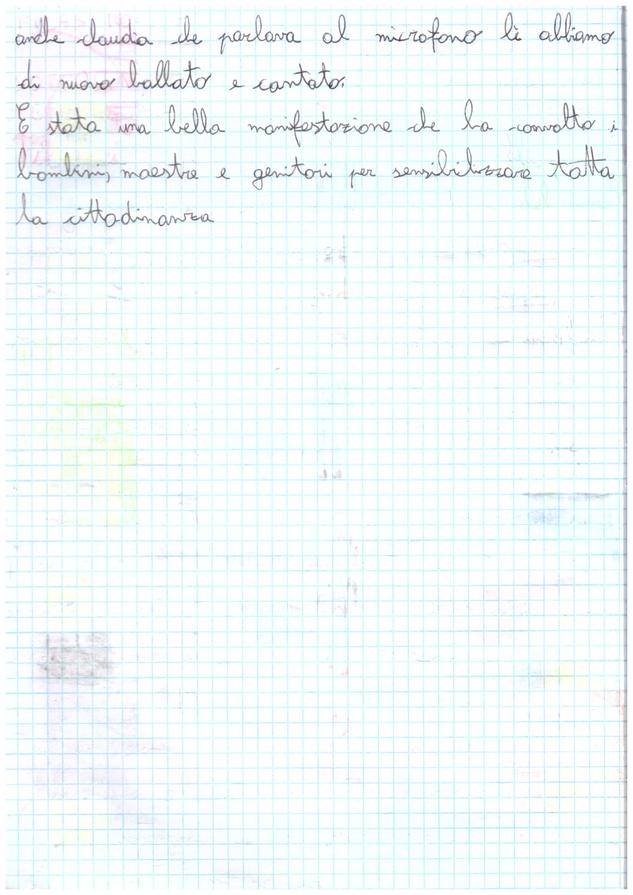
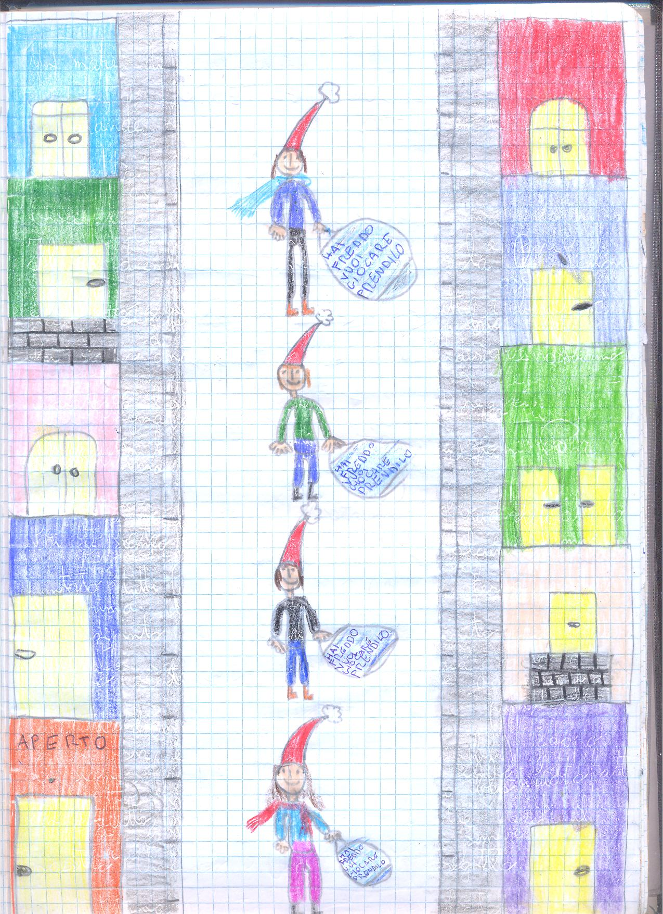

Slide 7
A SHORT STORY:
I’m Santa Shark. I live under the sea.
With the
Elf Sharks, I make toys for fish.
Reindeer Sharks wrap them up!

Slide 8
On Christmas Eve they load the sleigh...
…. and swim away under the sea. Santa Shark gives presents to all the sea animals.

Slide 9
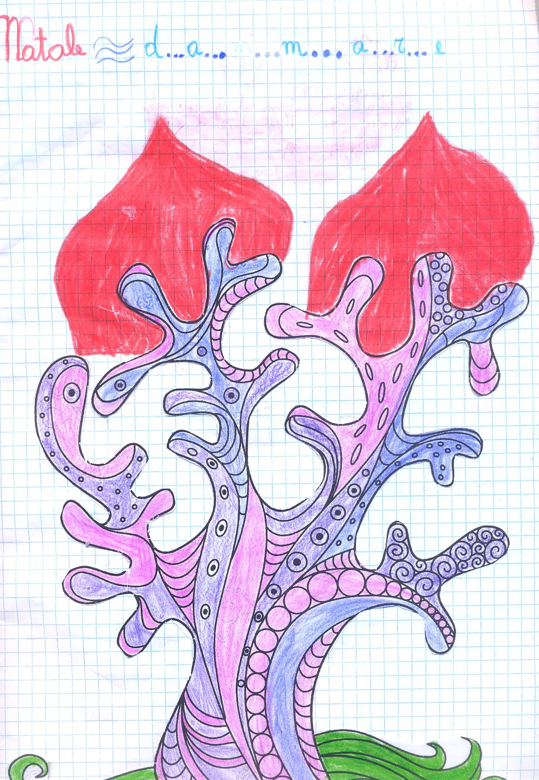
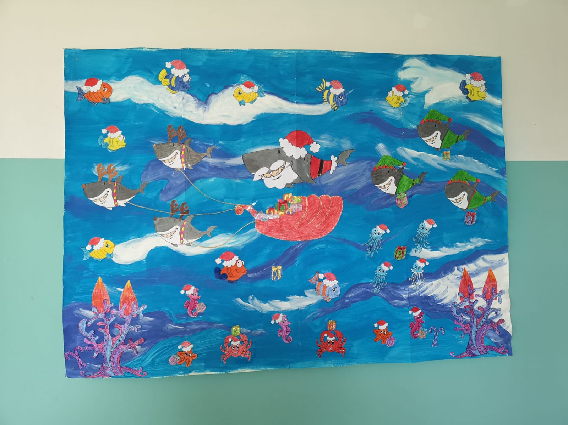

Slide 10
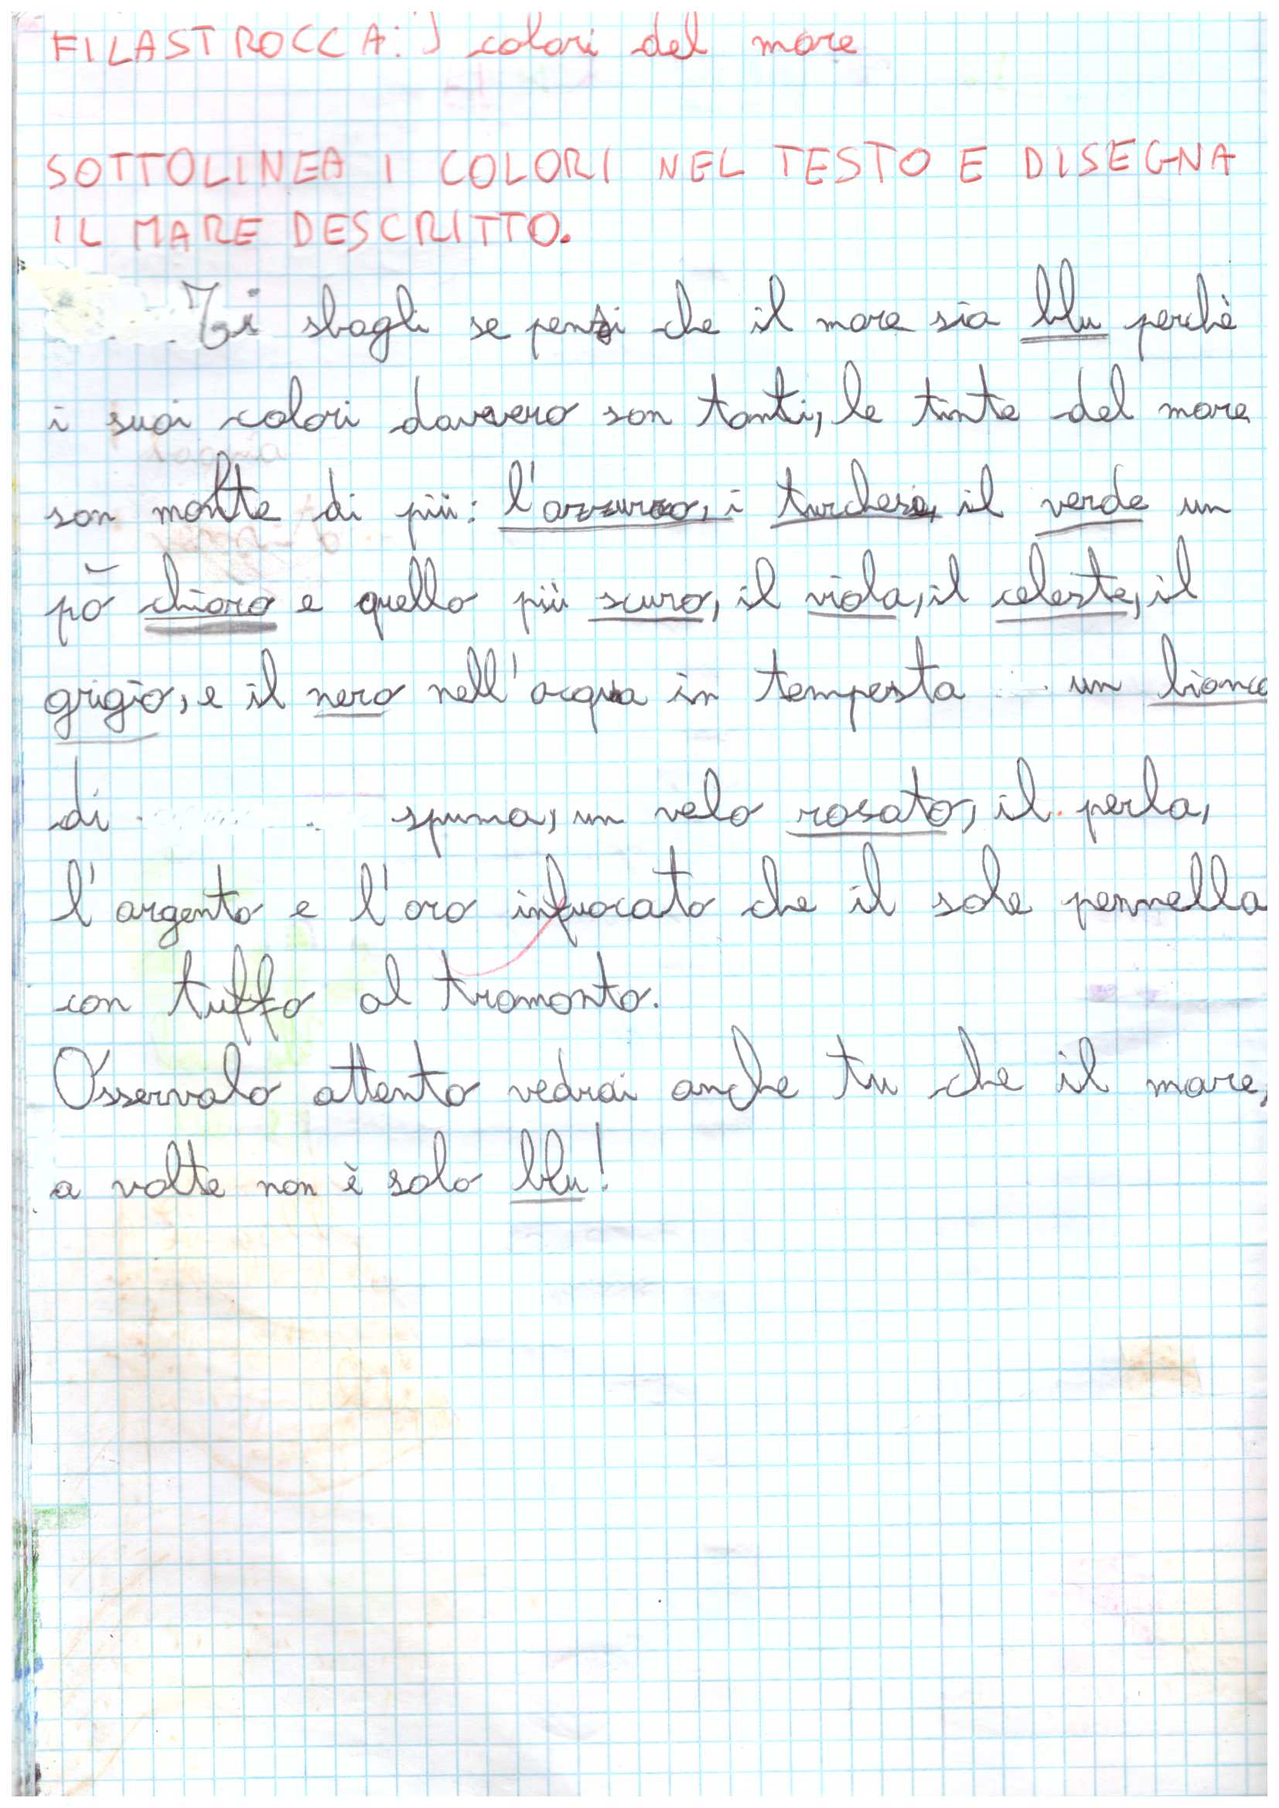
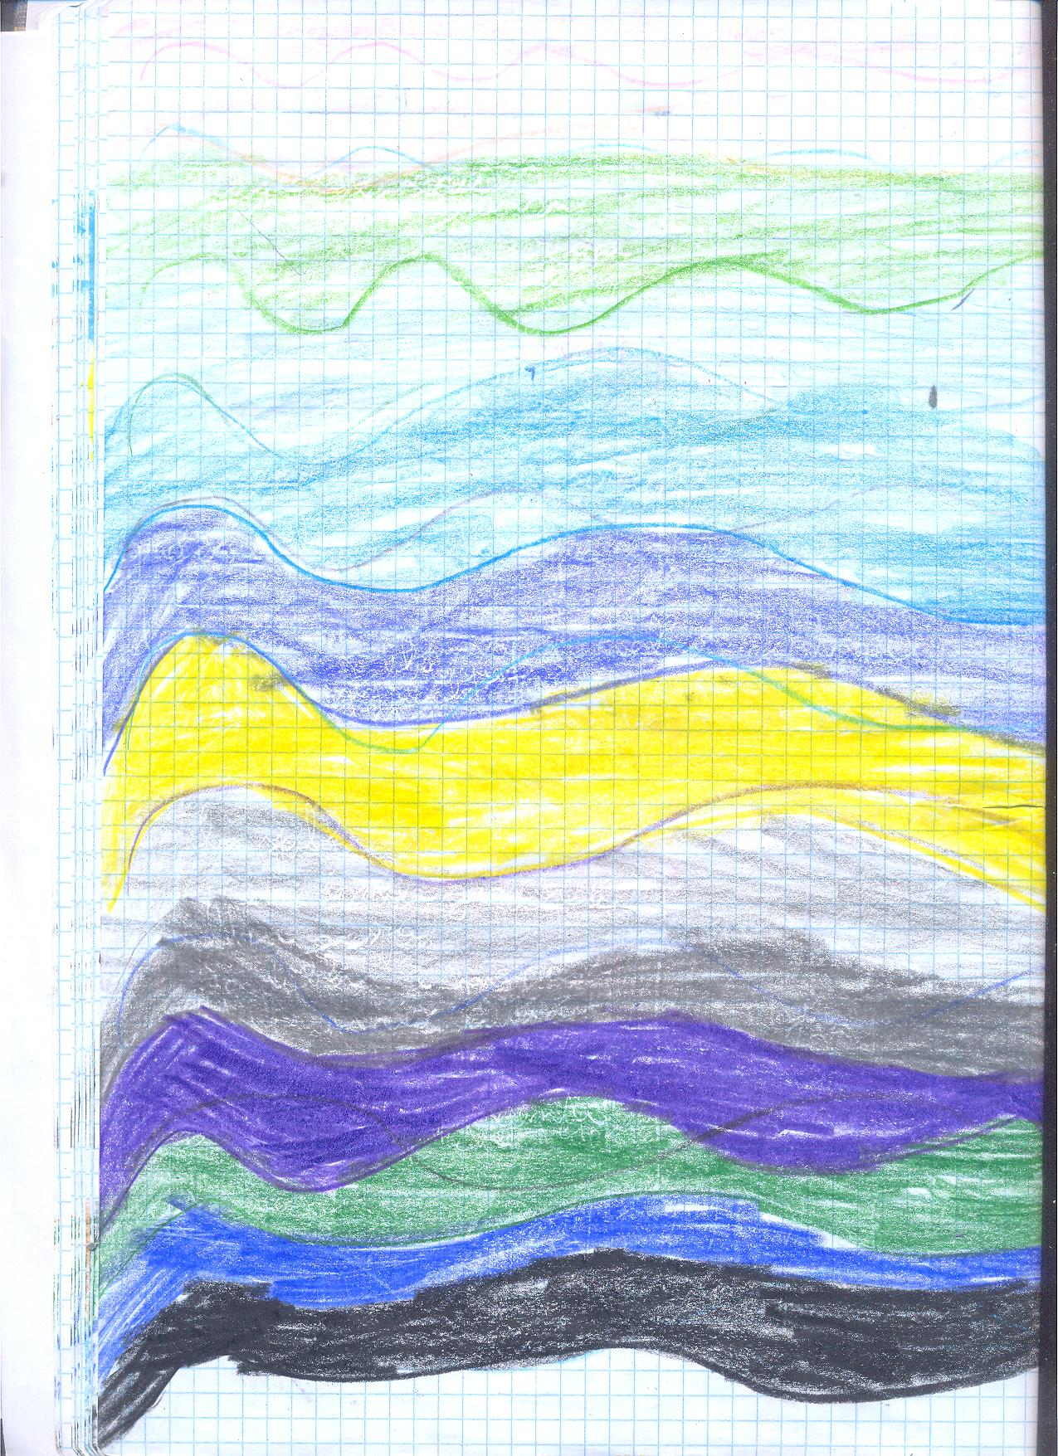

Slide 11
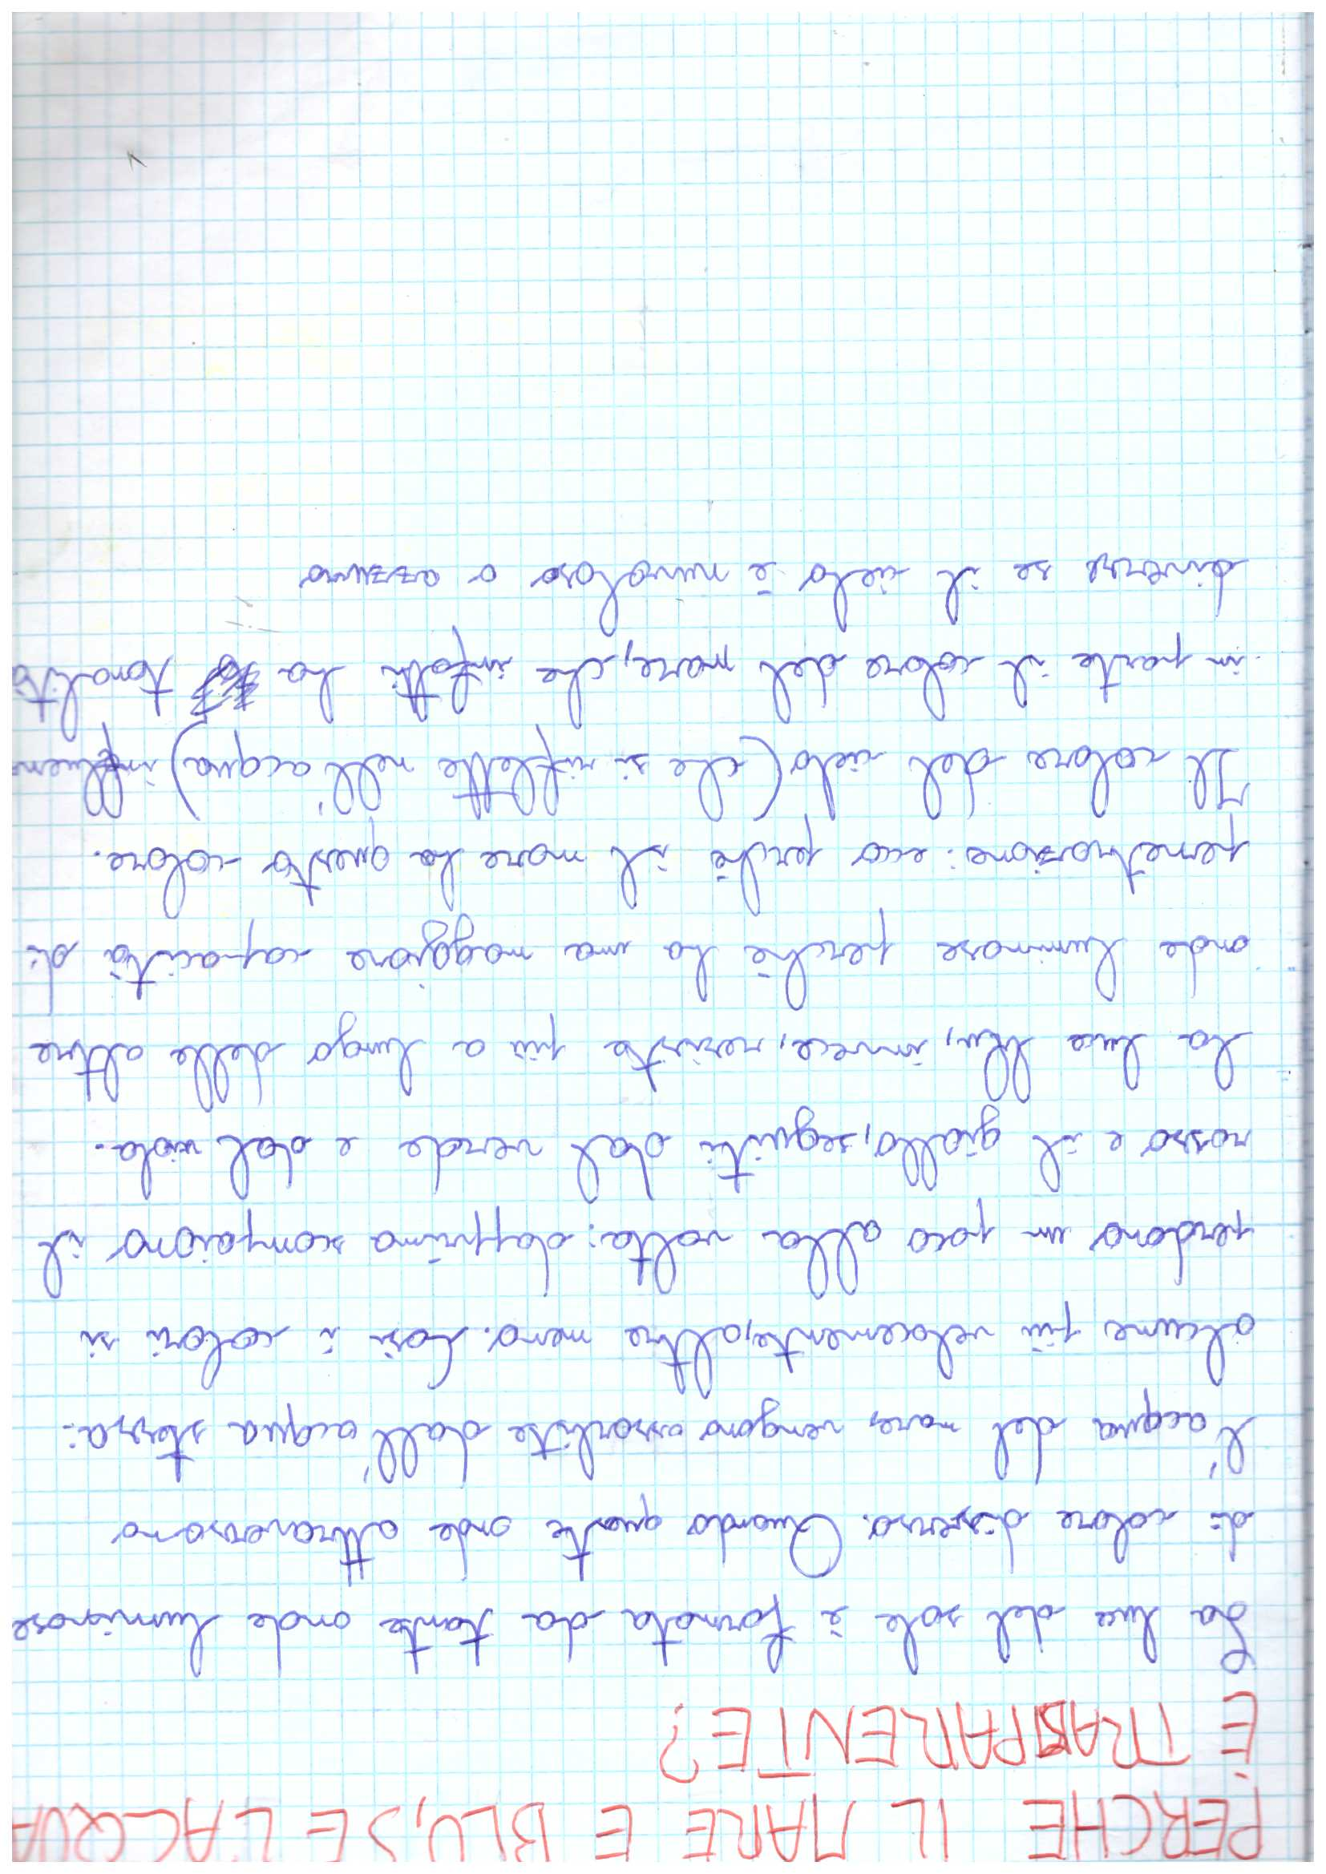

Slide 12
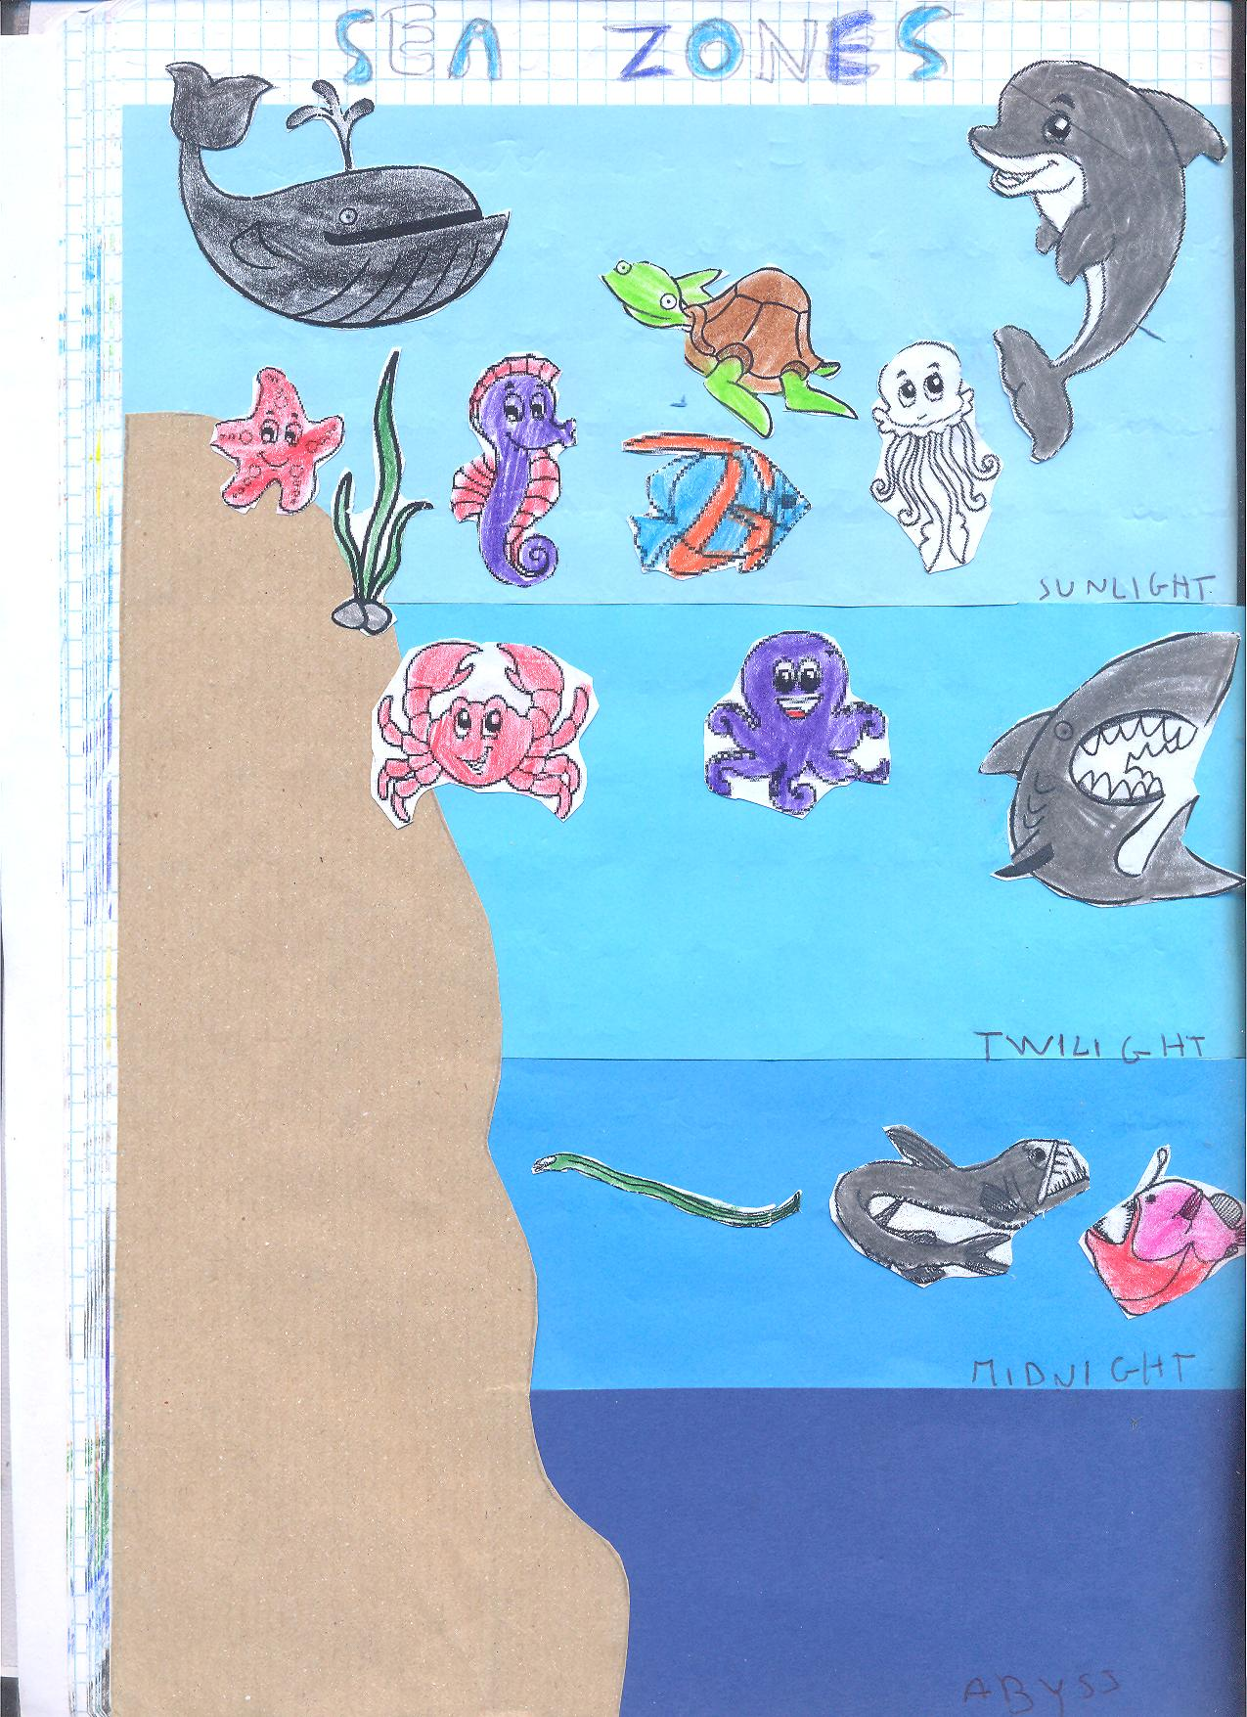
SUNLIGHT: this is the only zone fully lit
by the sun. Plants and animals live here.
TWILIGHT ZONE: very little sunlight
reaches this zone. No plants grow here.
MIDNIGHT ZONE: very dark, no sunlight
and no plants.some animals make
their own light.
ABYSS:cold and completely dark.
Very few animals live in this zone.

Slide 13
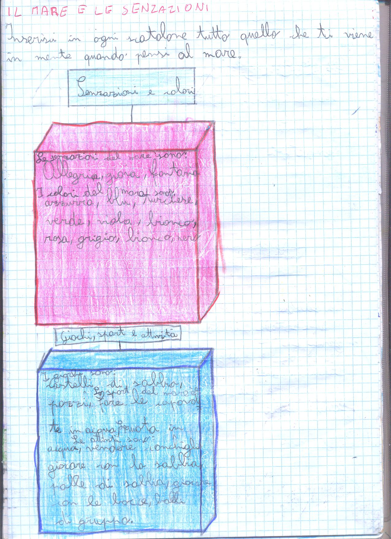
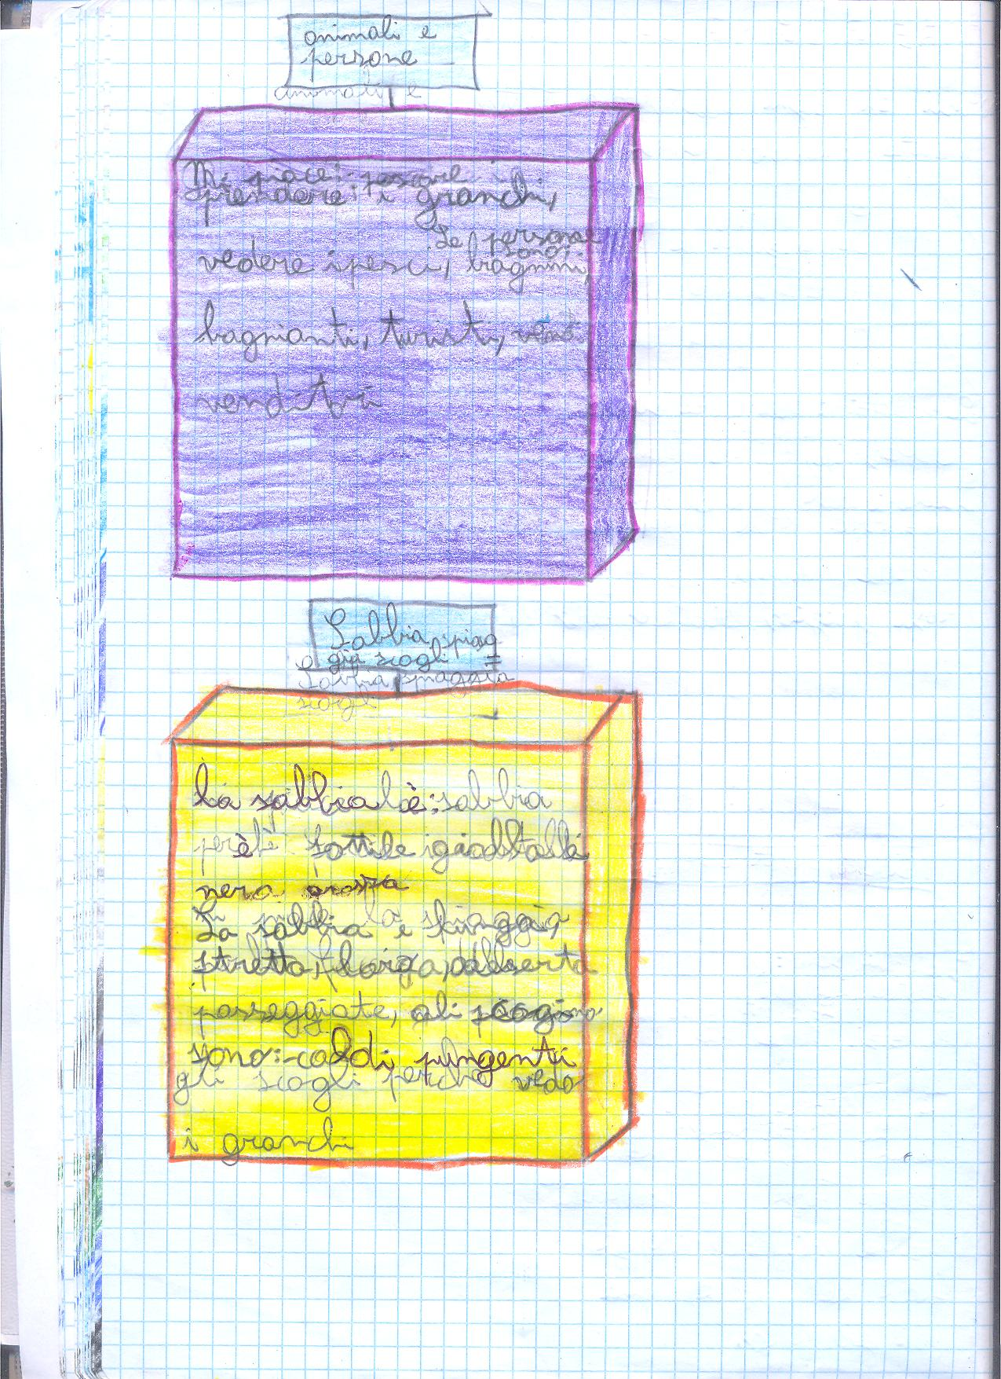

Slide 14
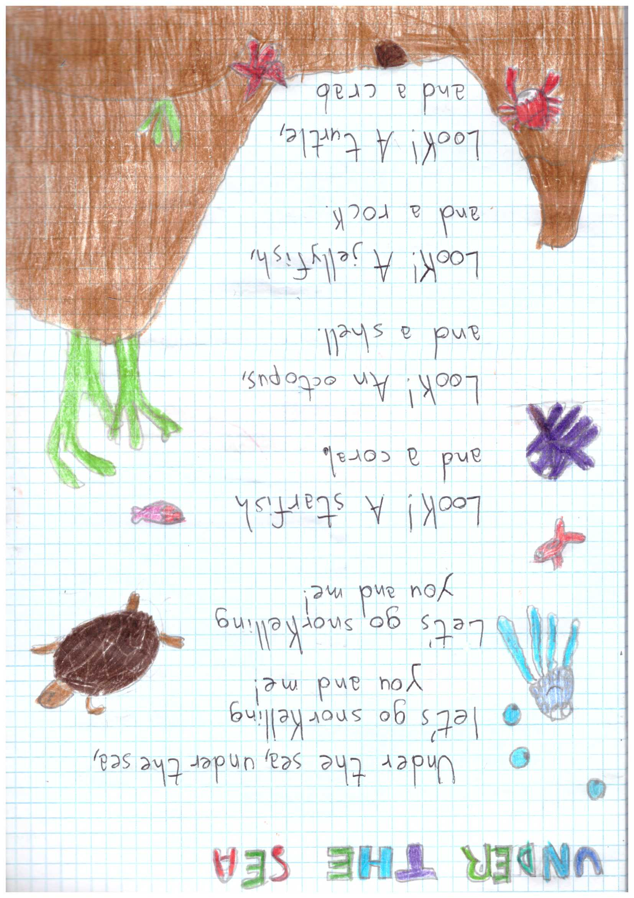

Slide 15
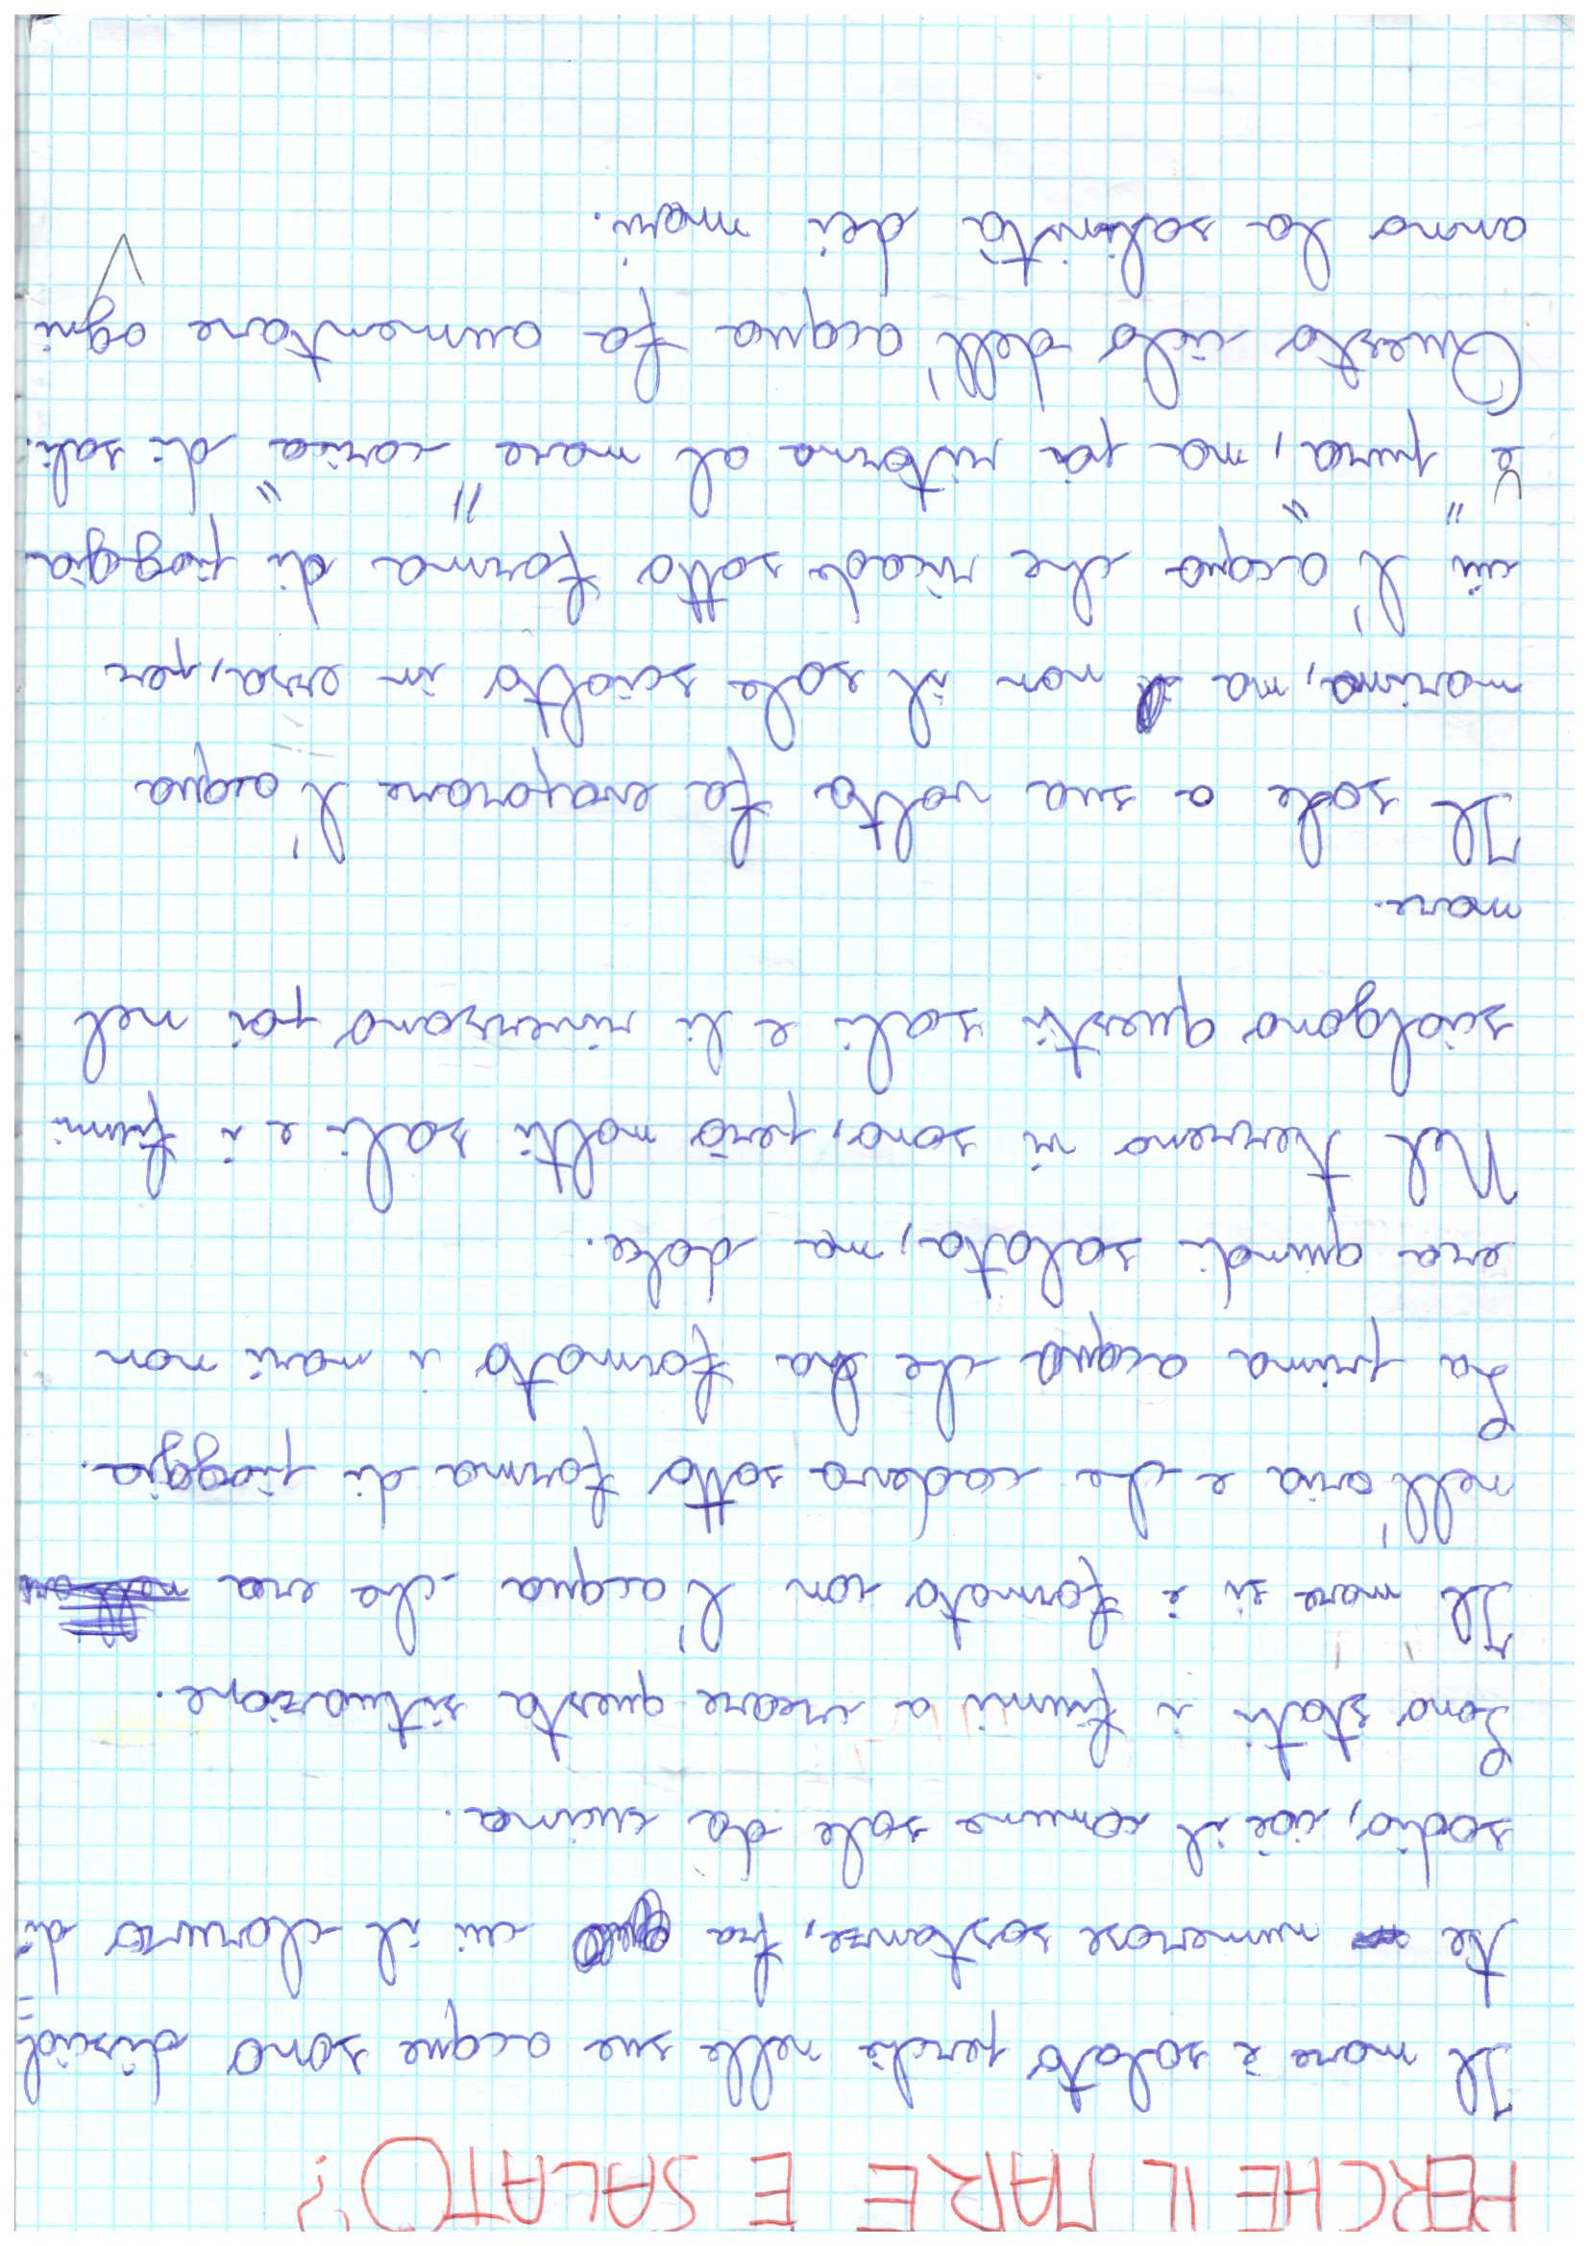
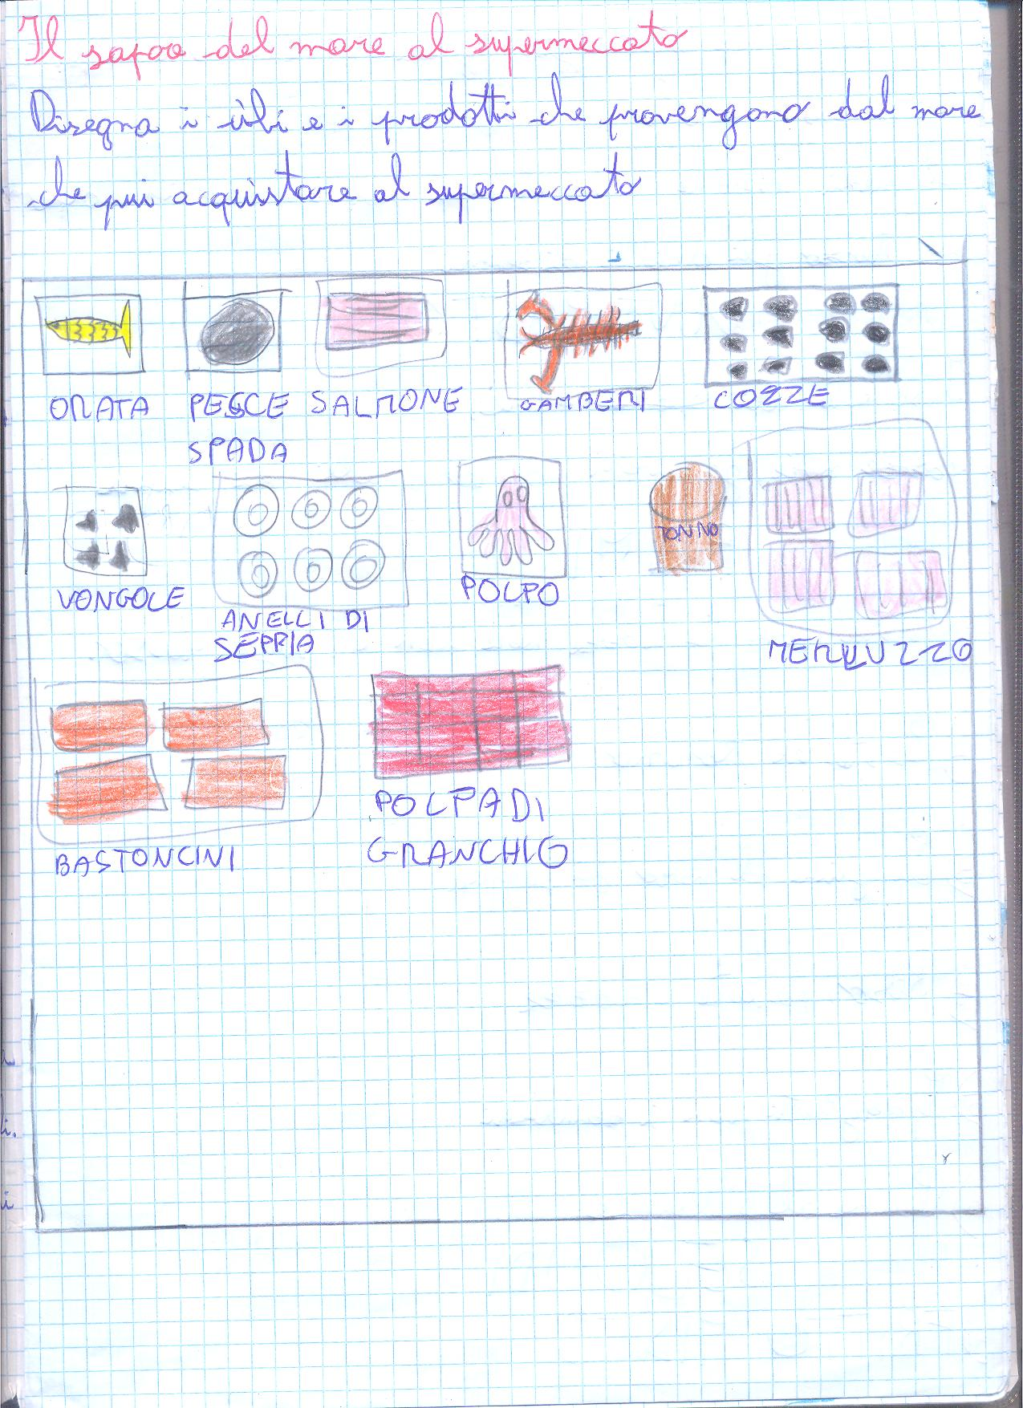

Slide 16
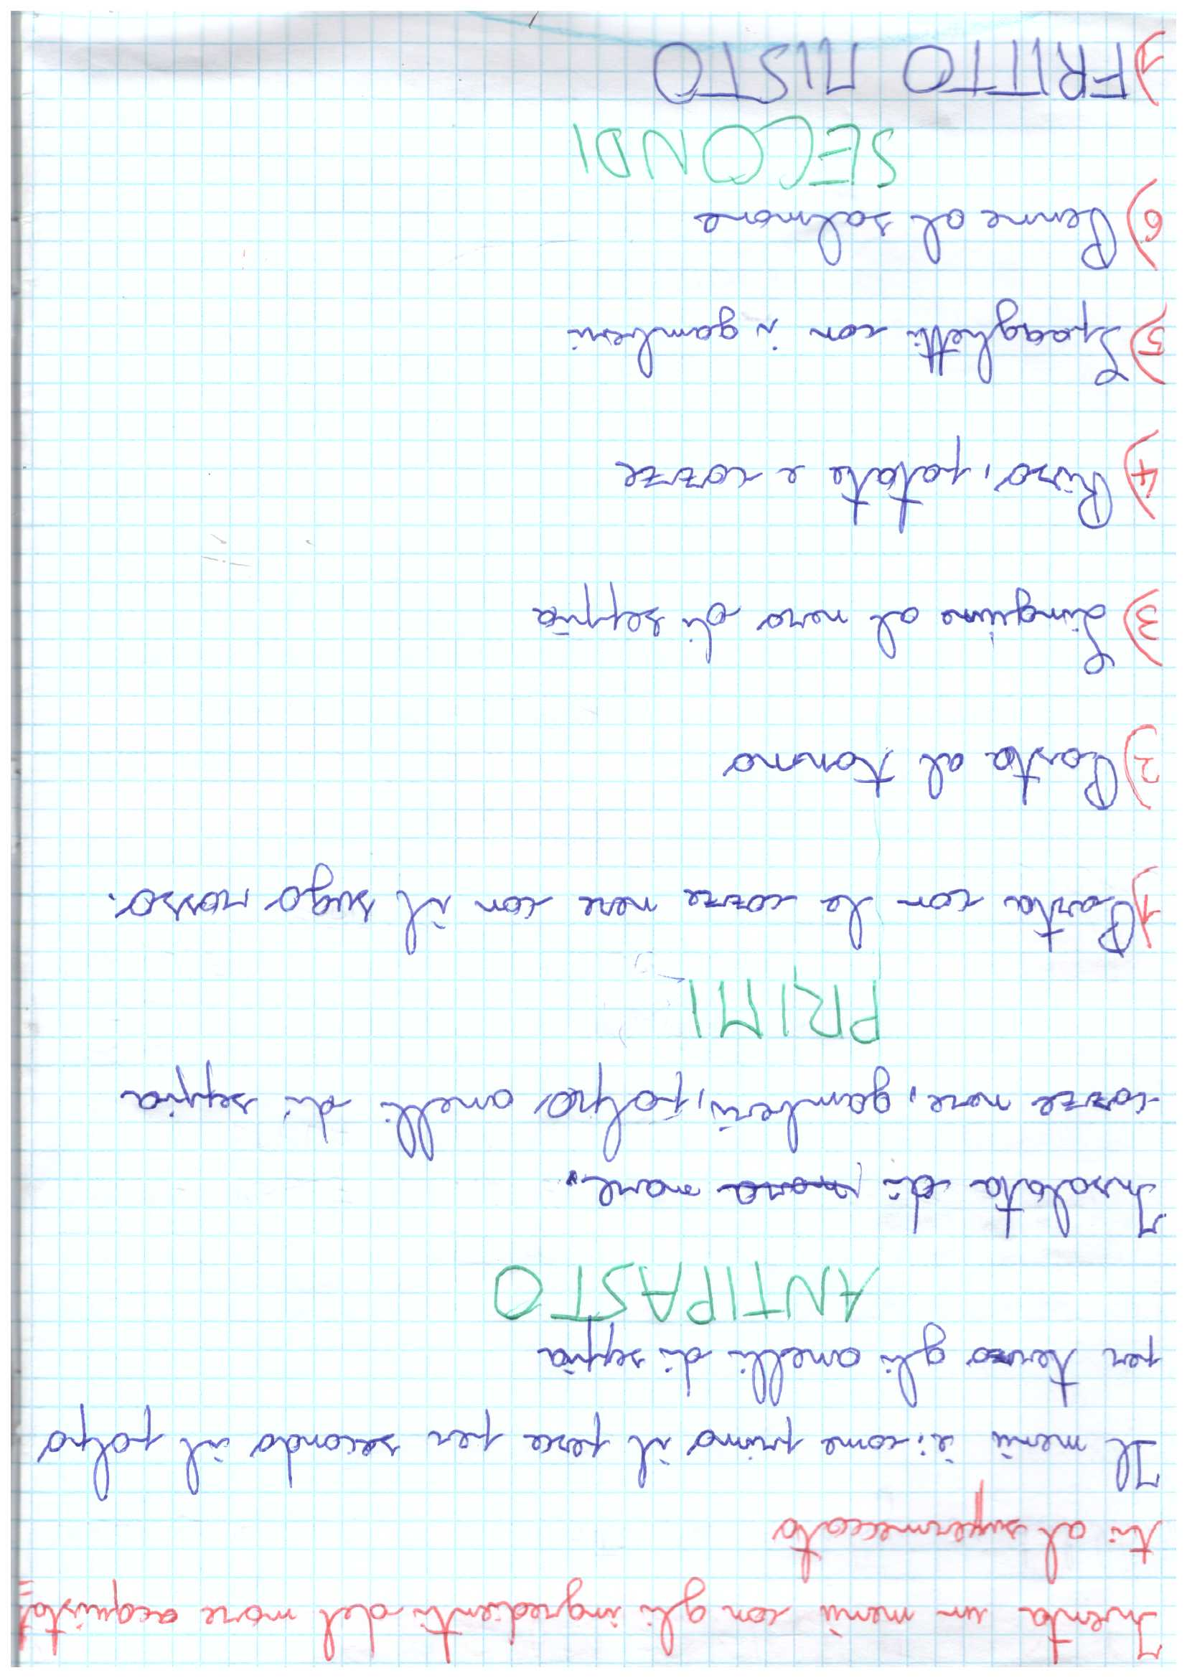

Slide 17
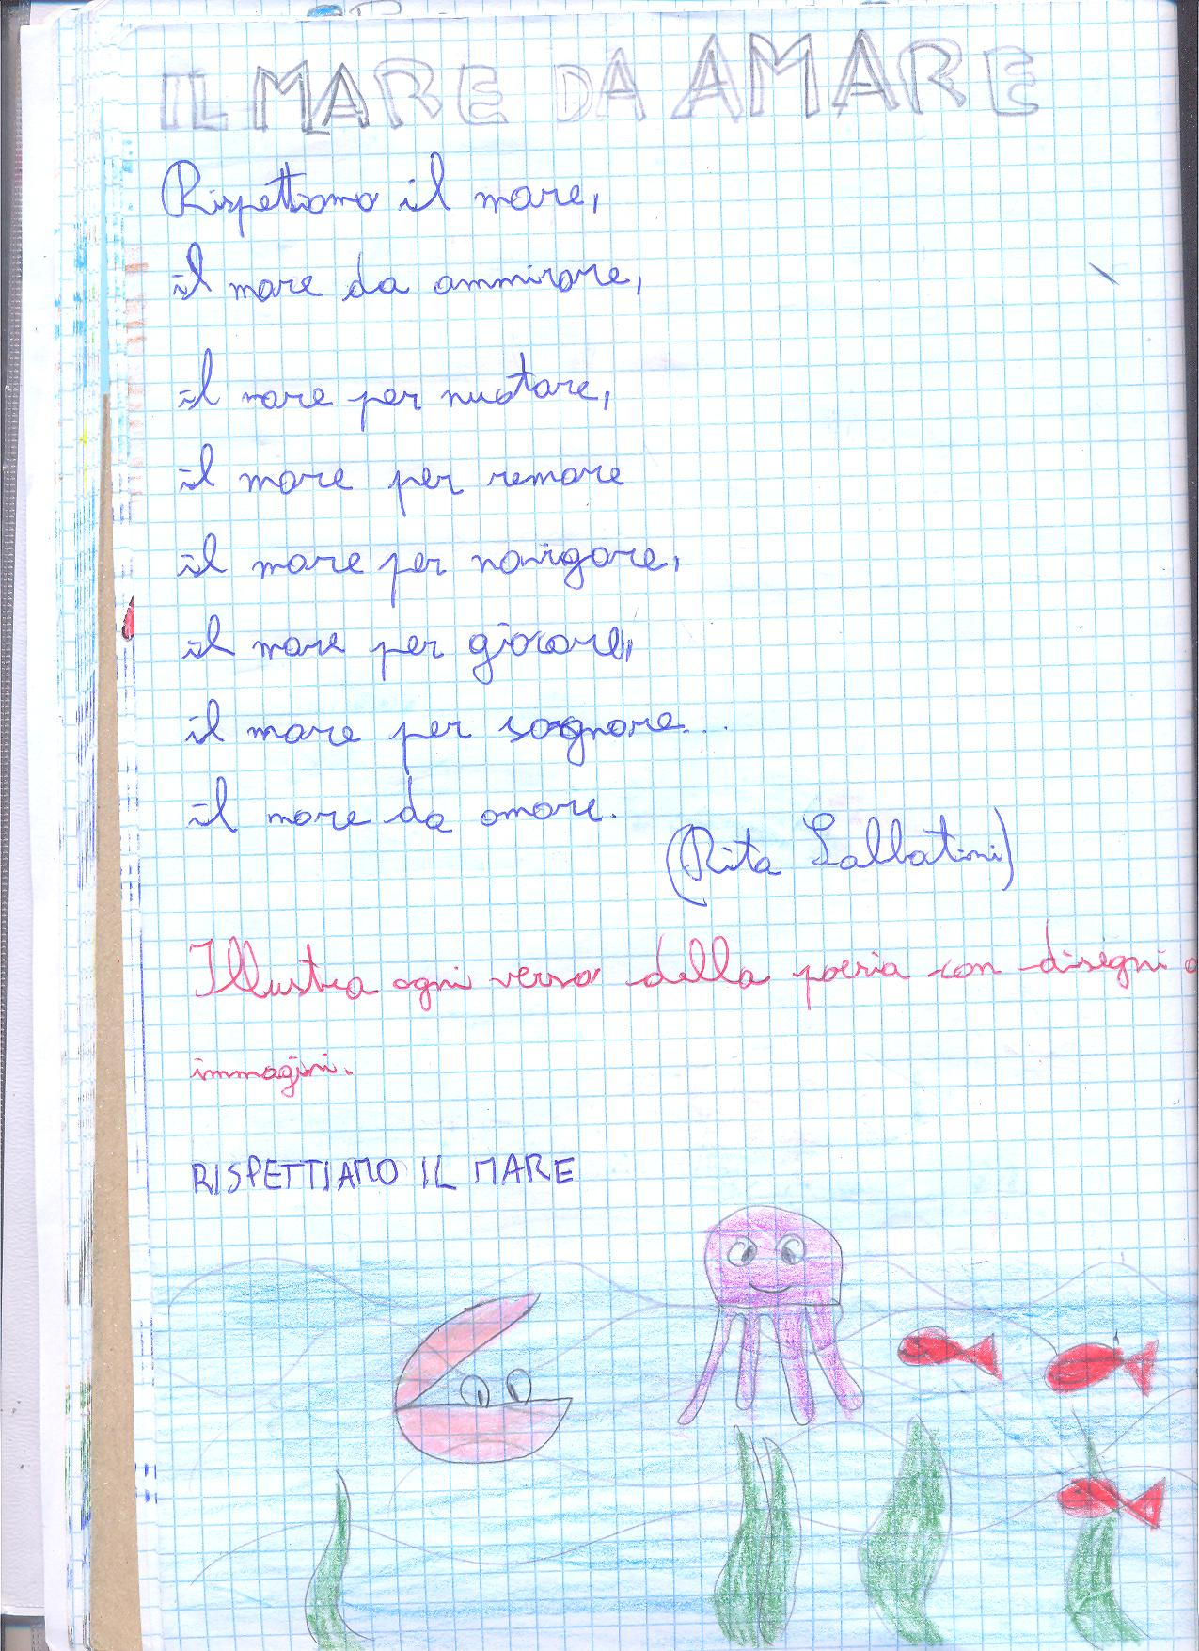

Slide 18
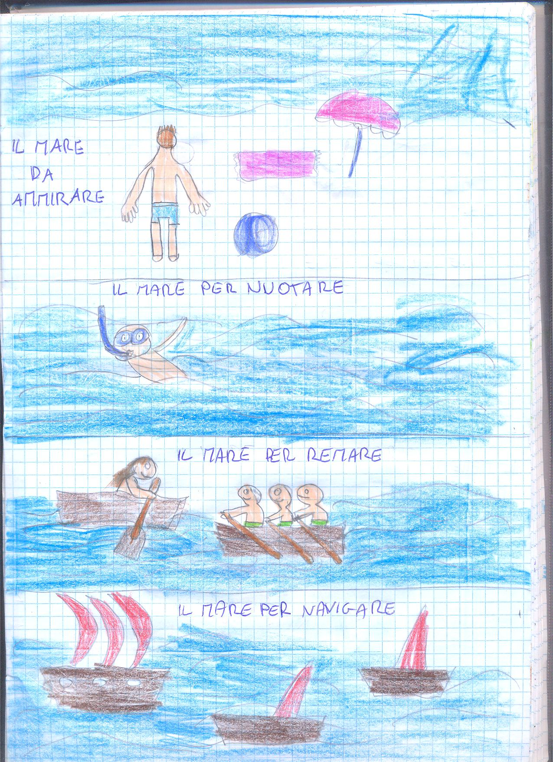
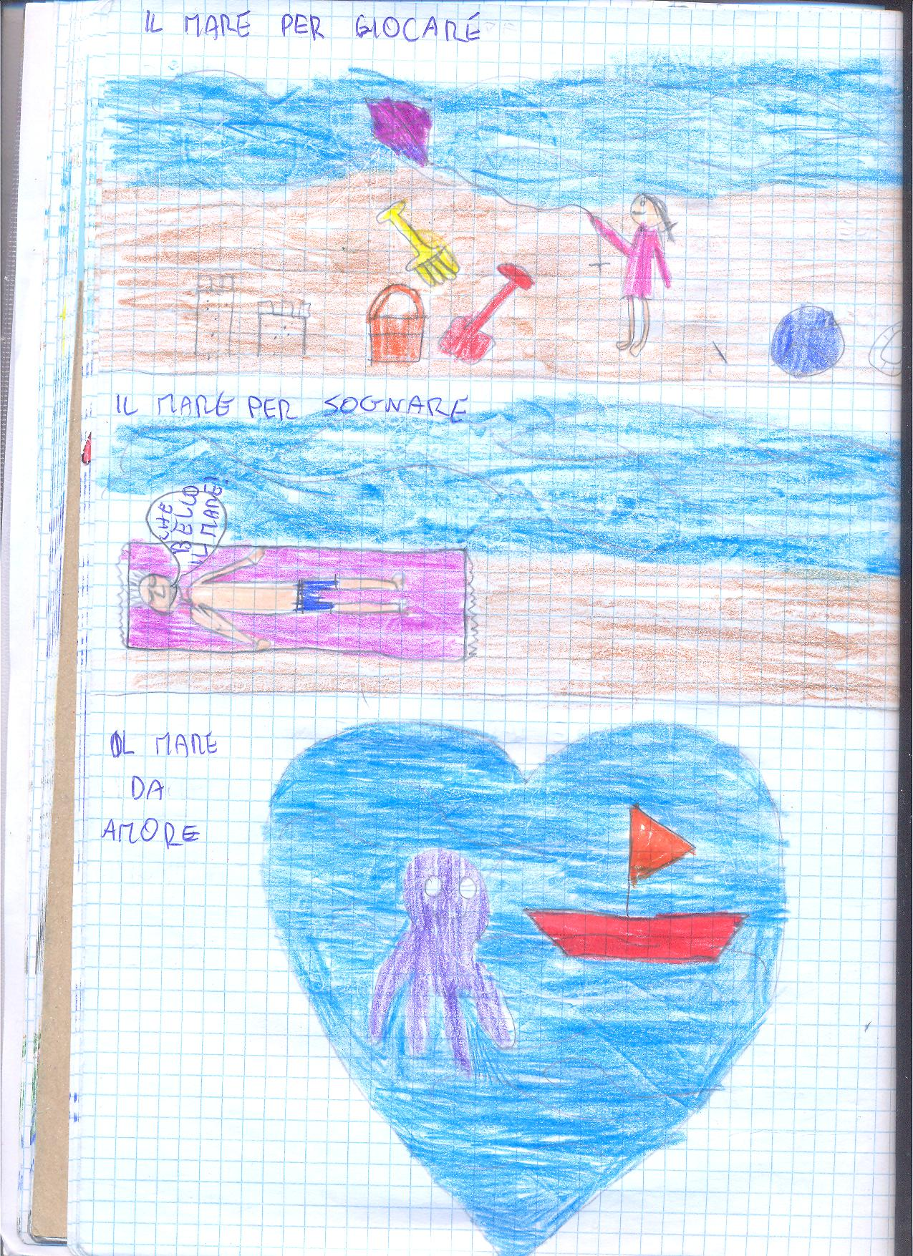

Slide 19
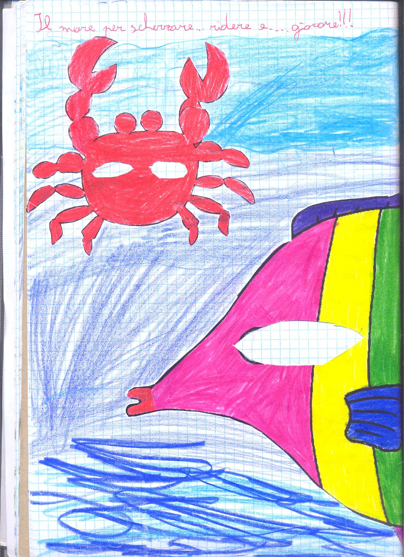
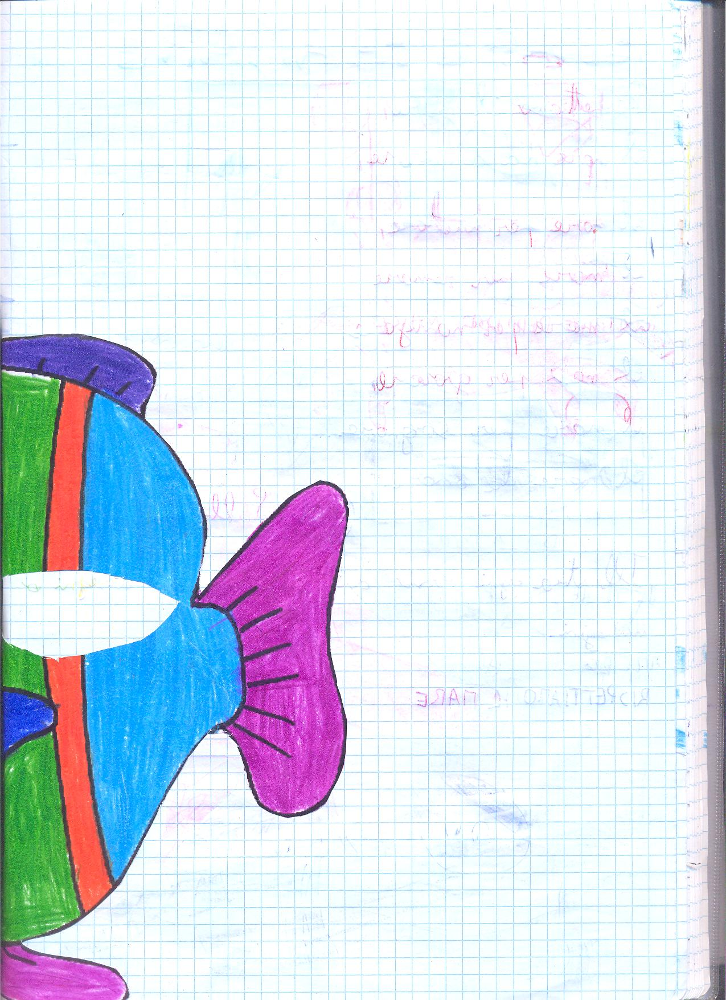

Slide 20
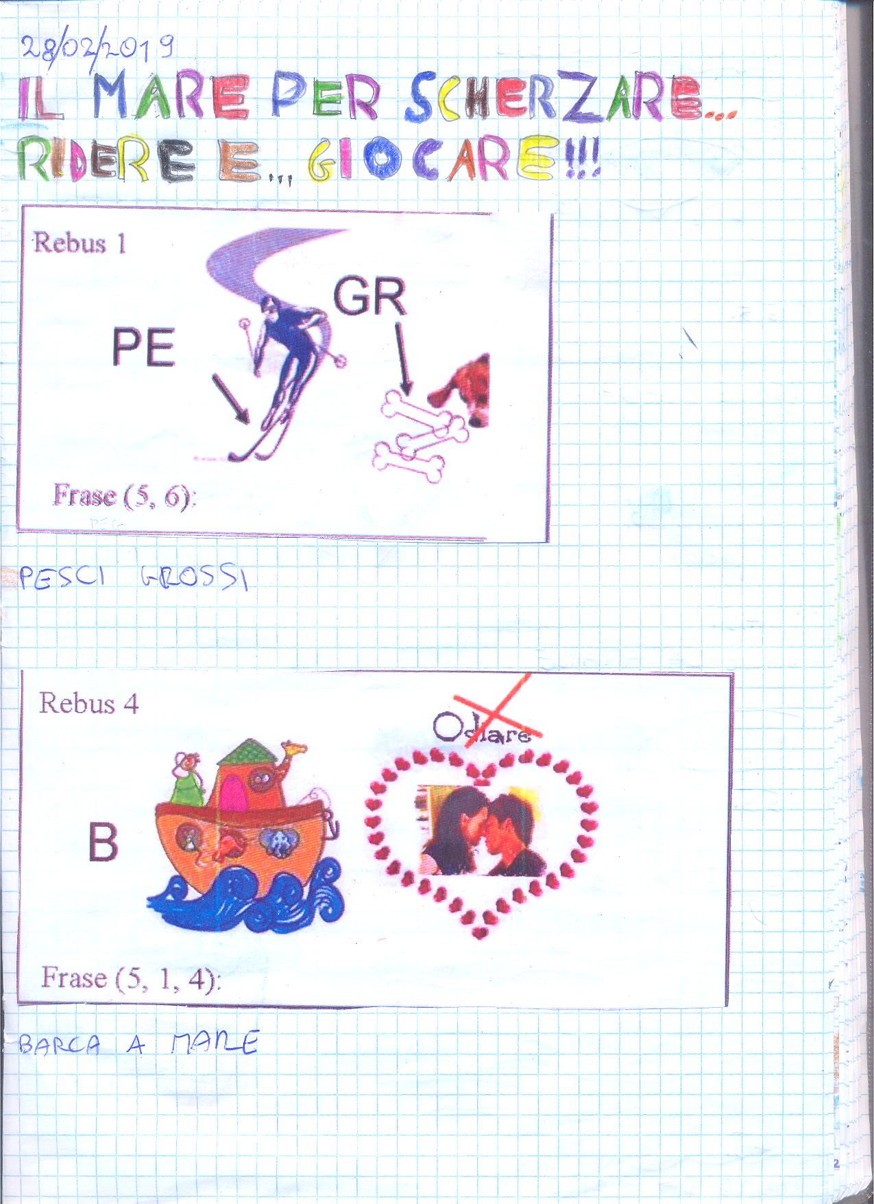
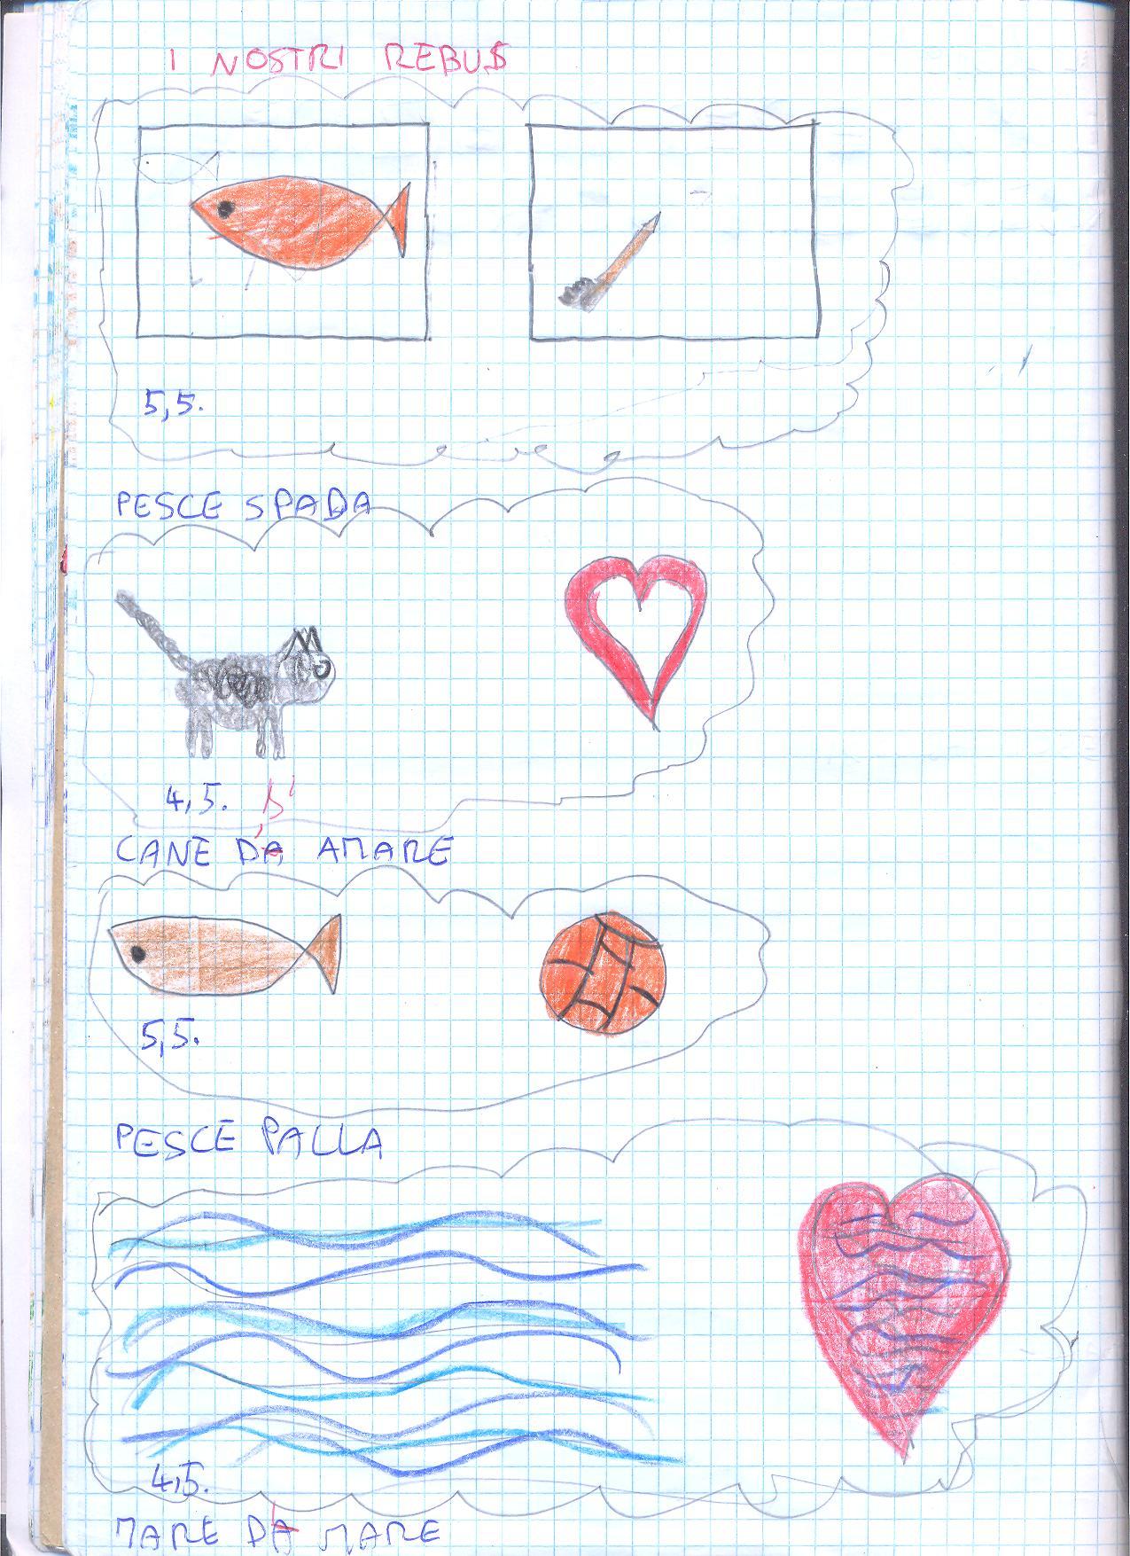

Slide 21
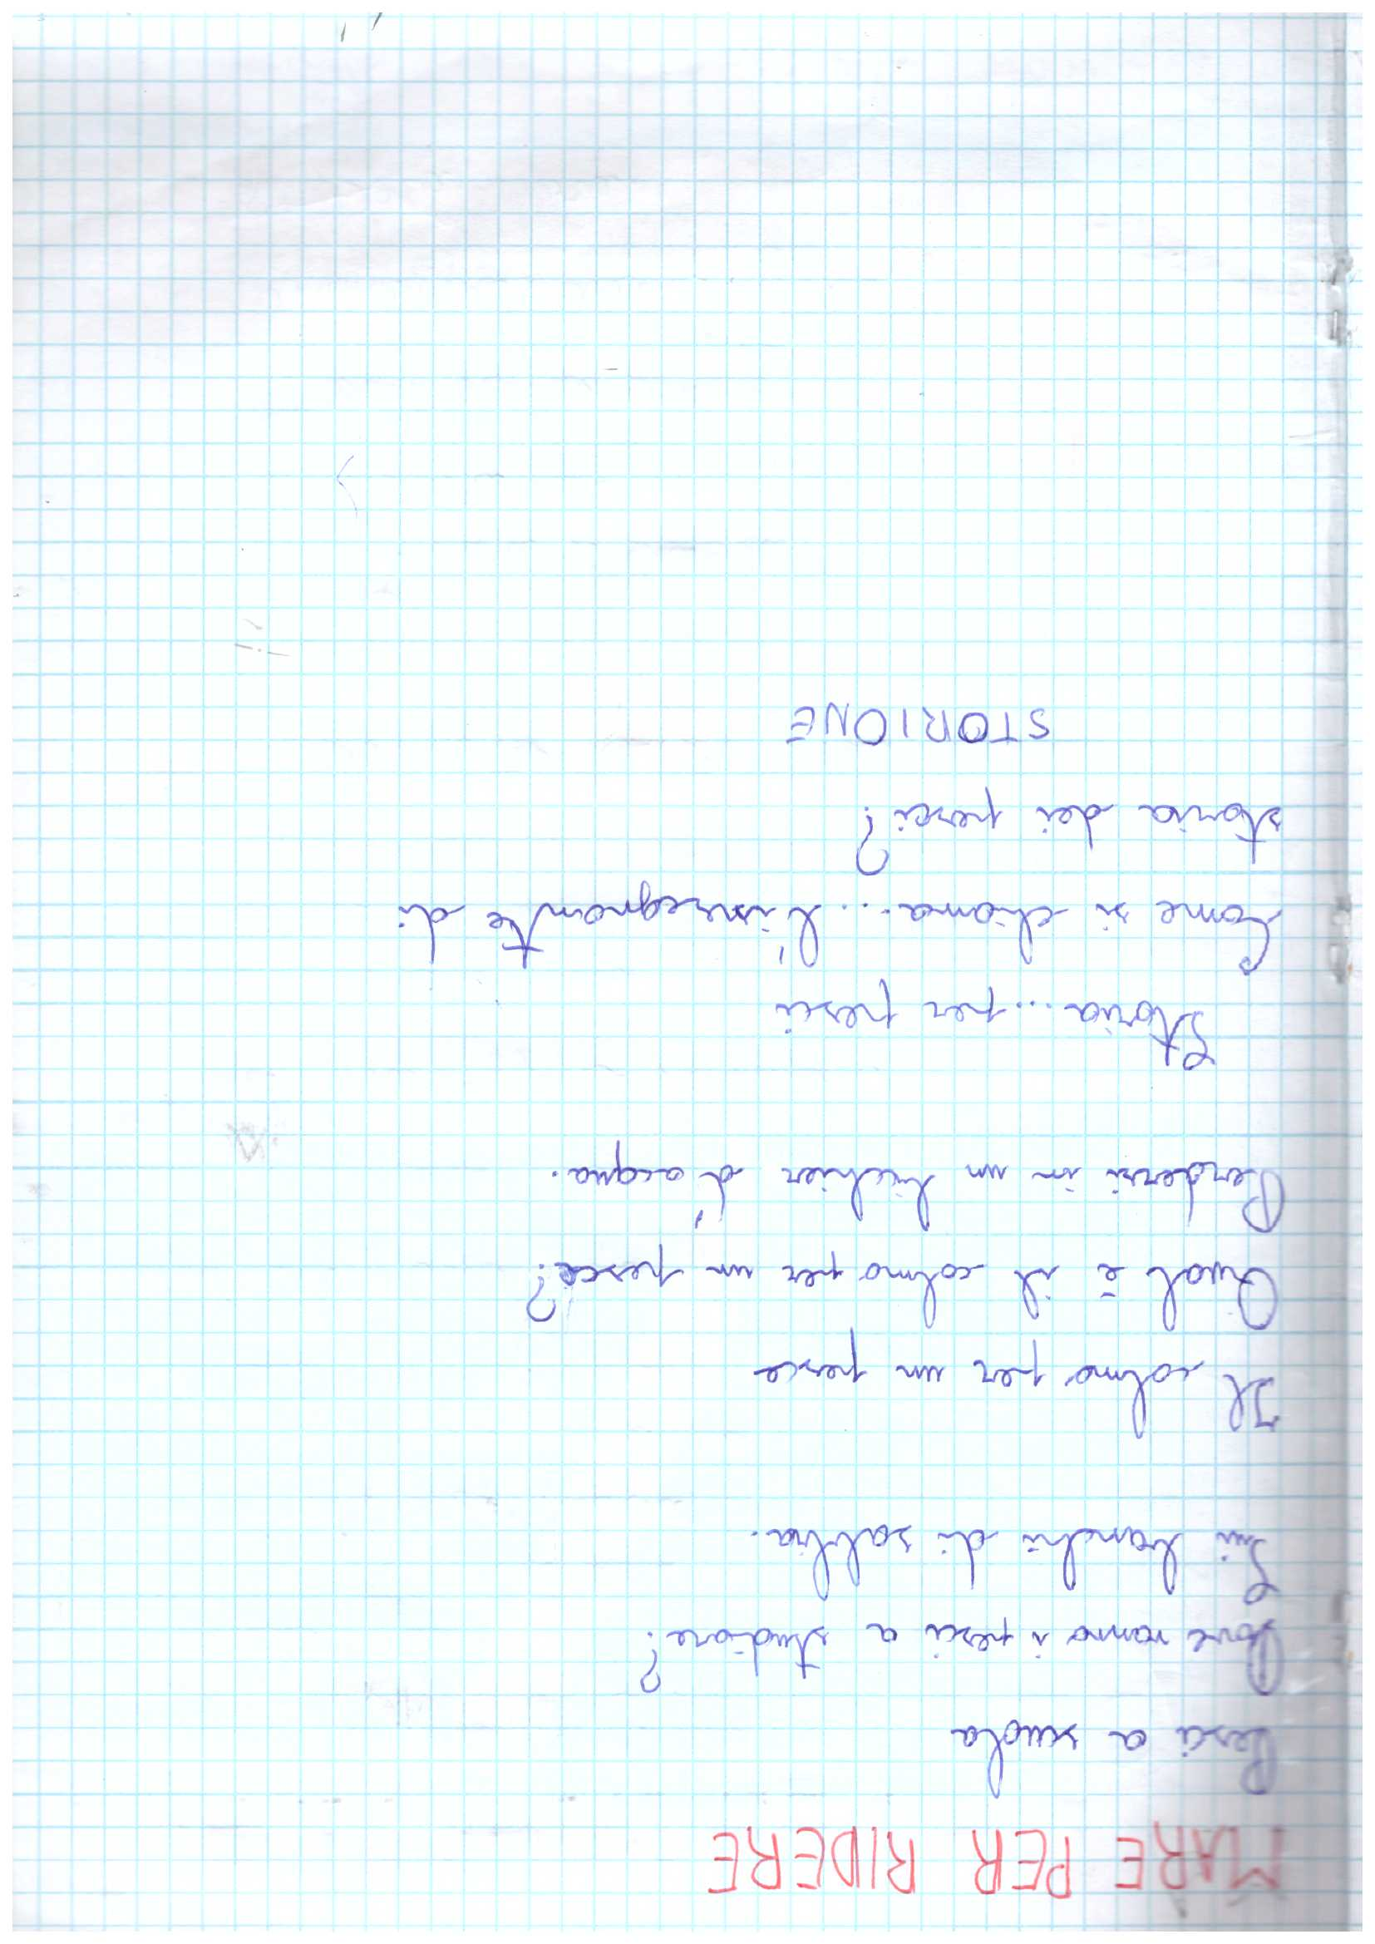
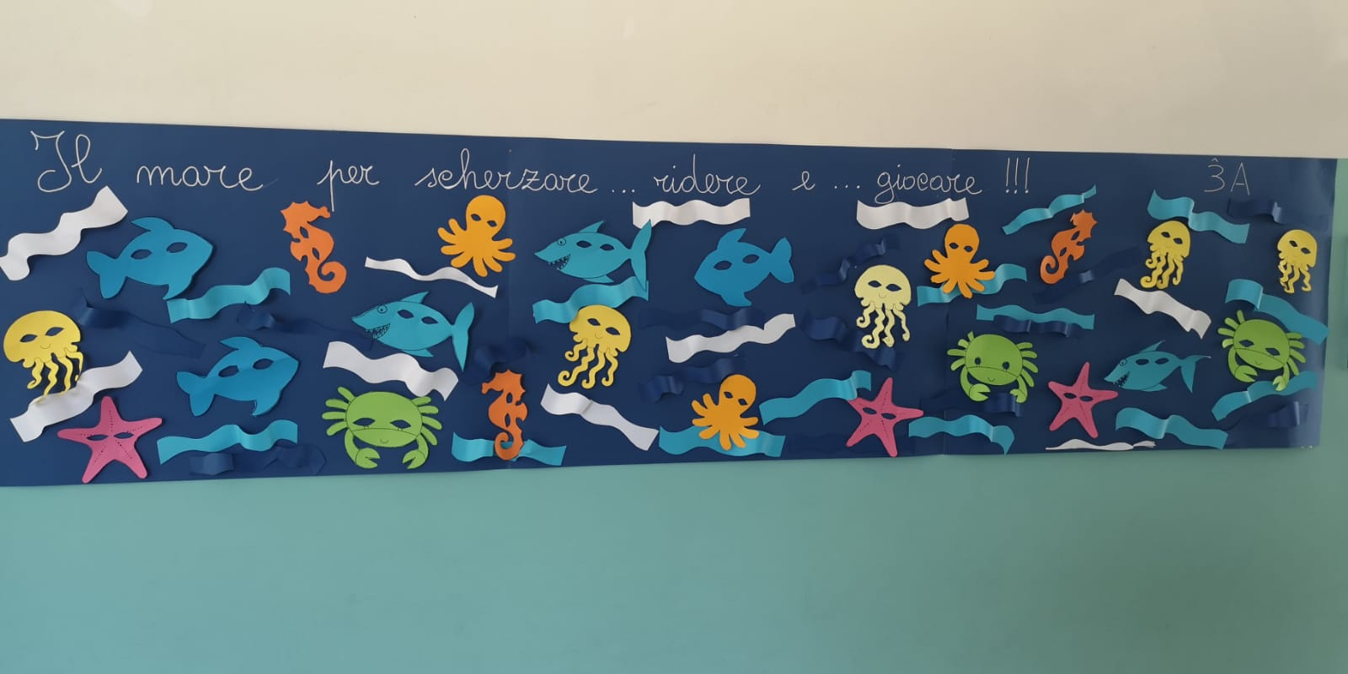

Slide 22
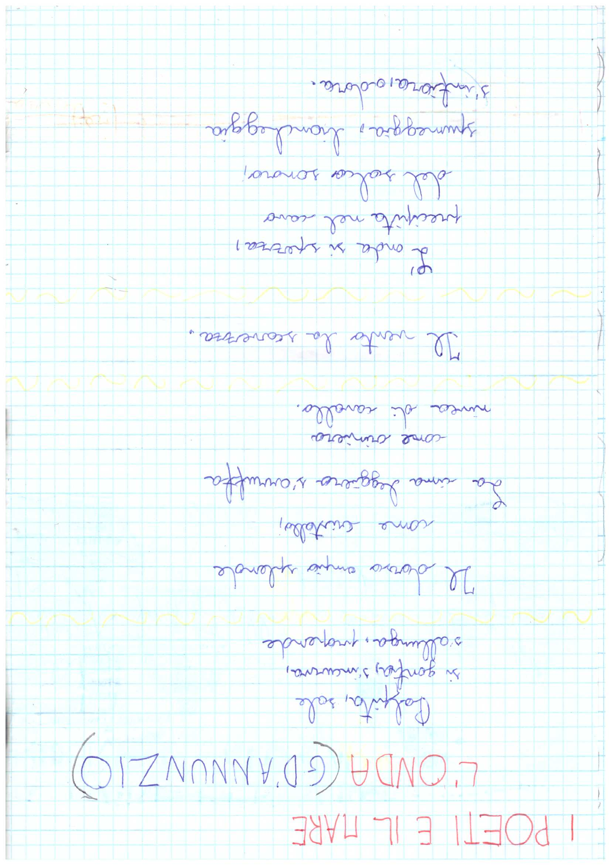

Slide 23
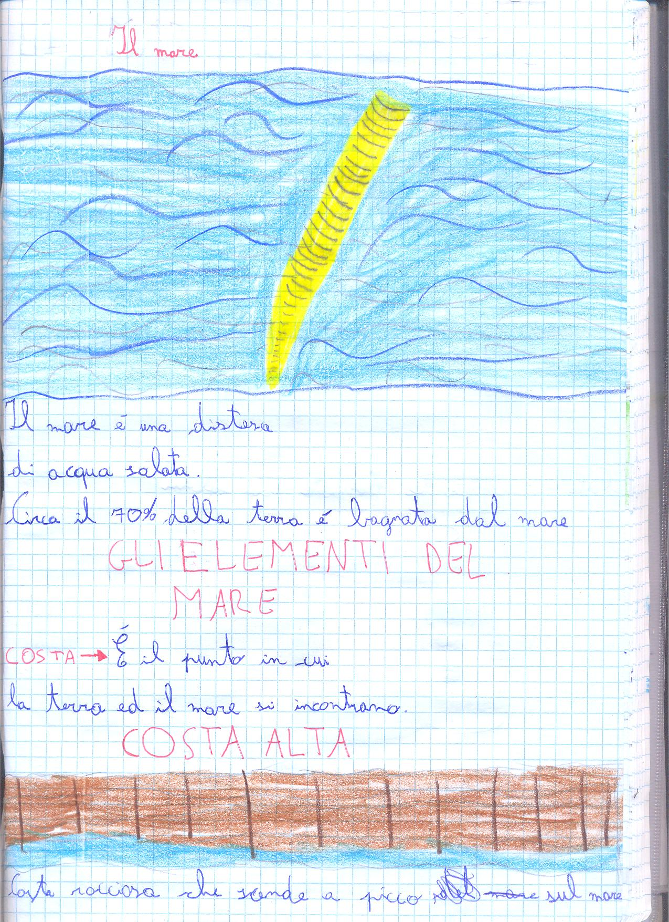
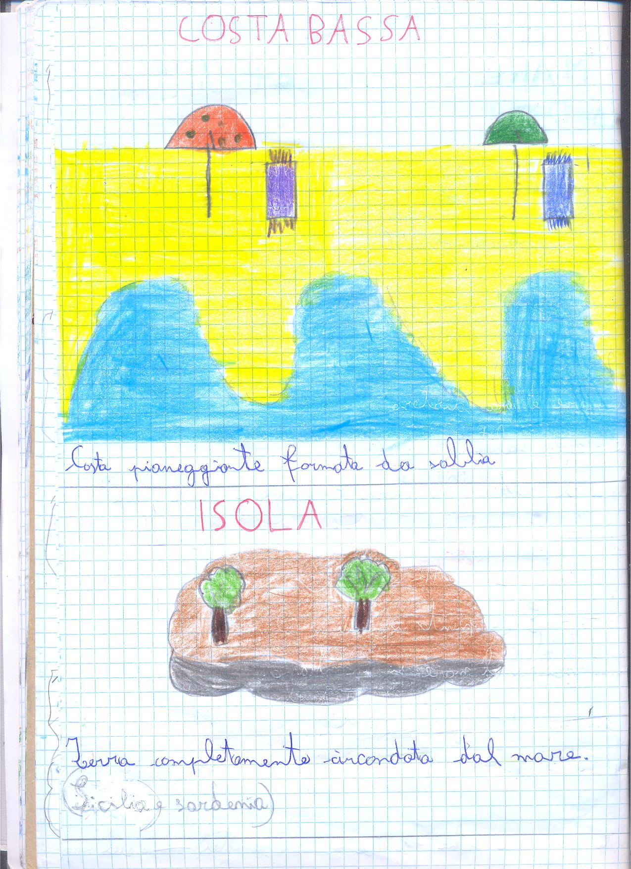

Slide 24
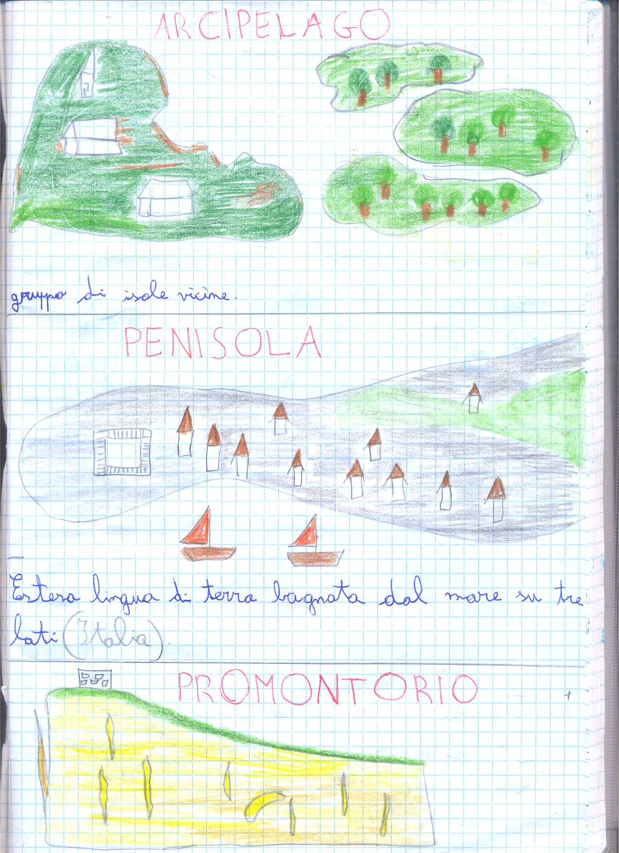
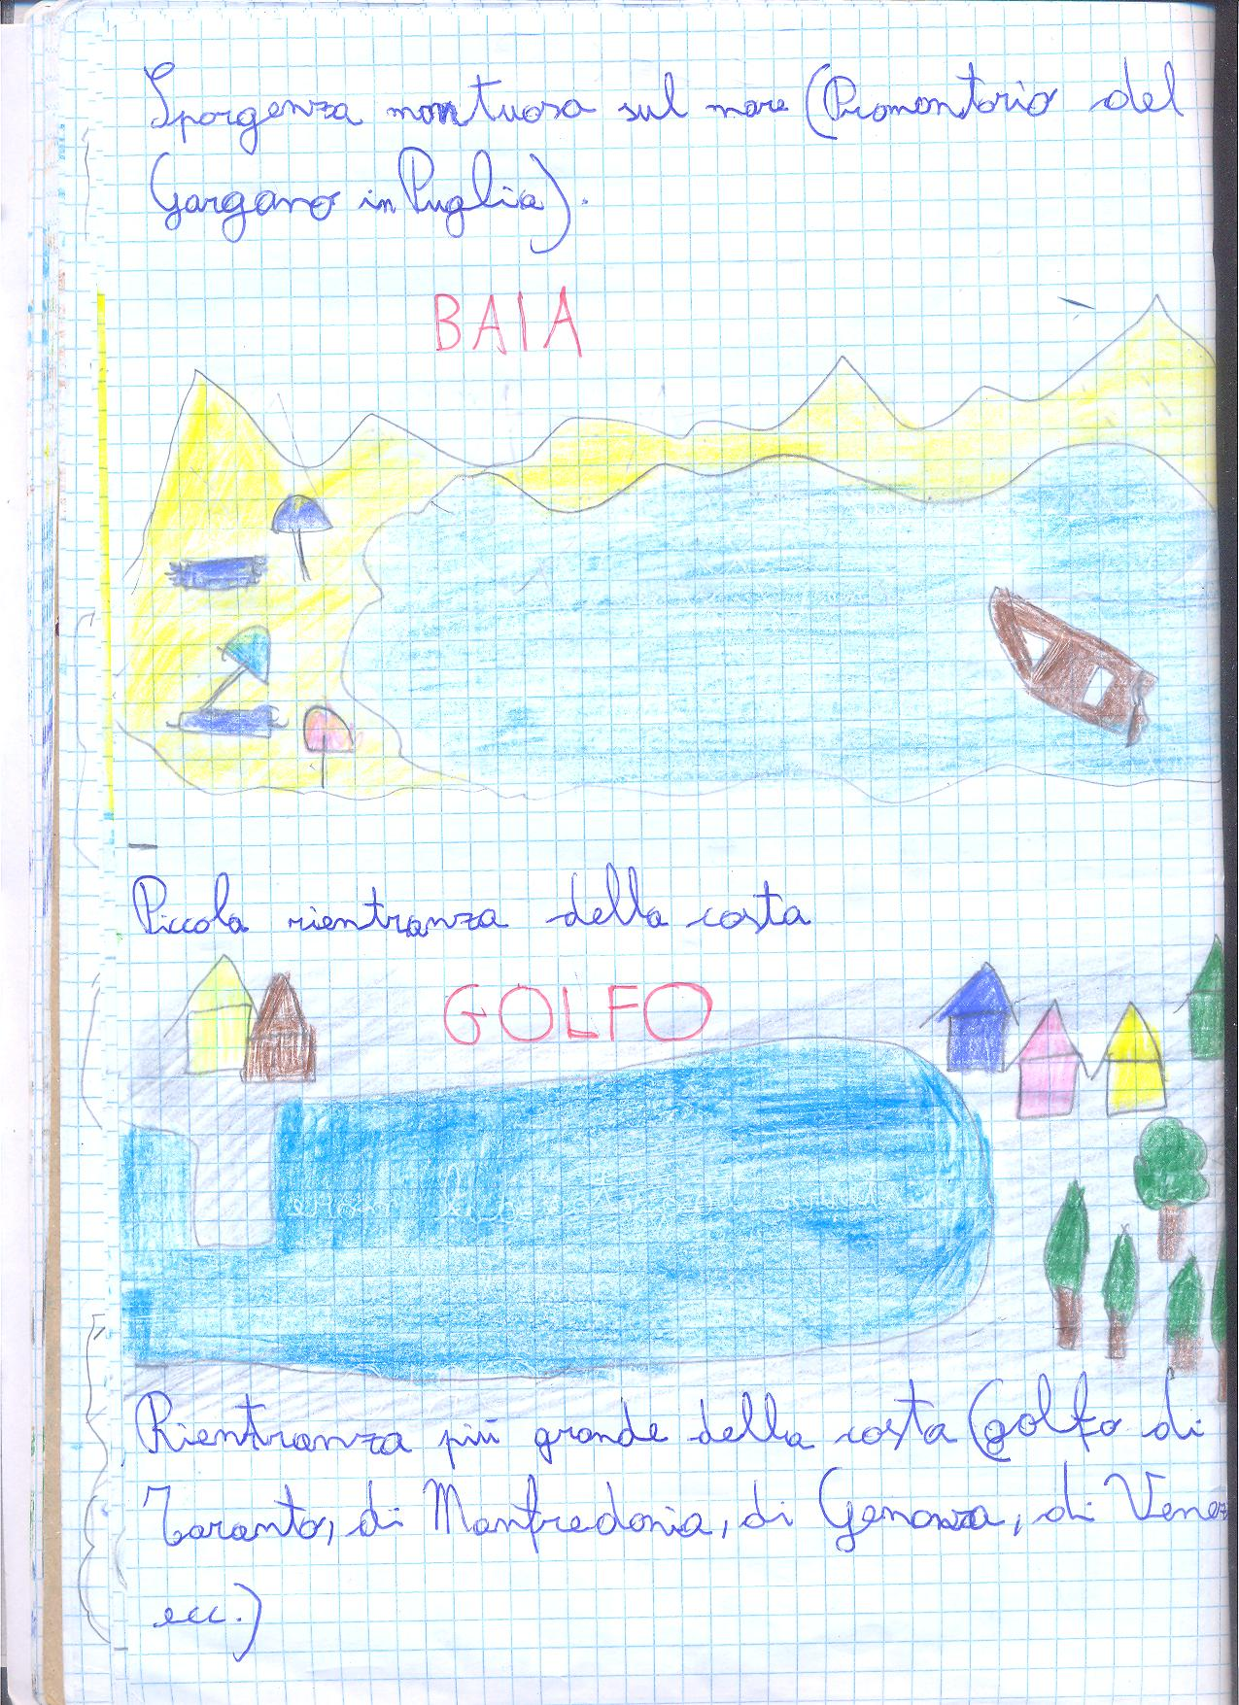

Slide 25
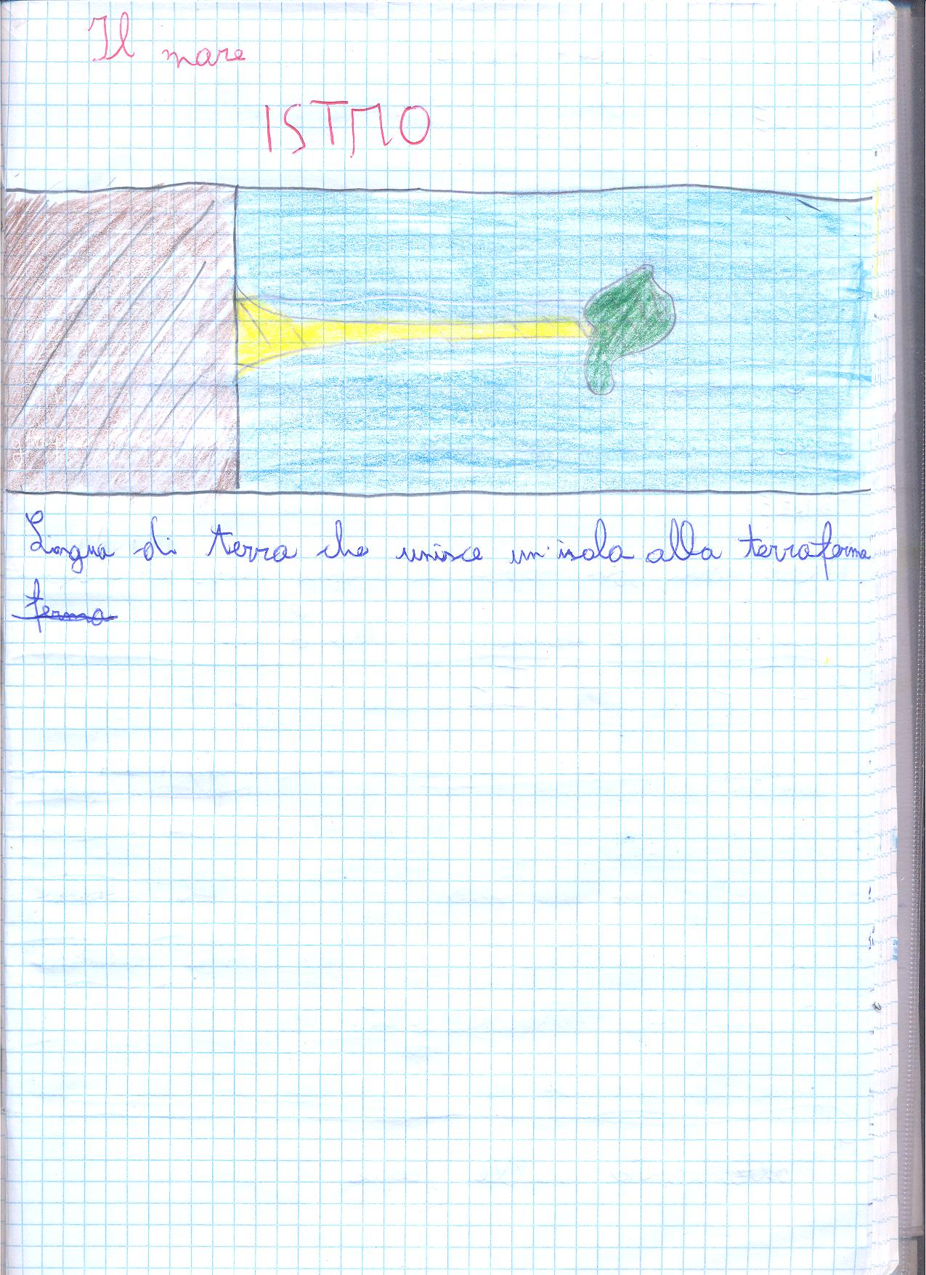
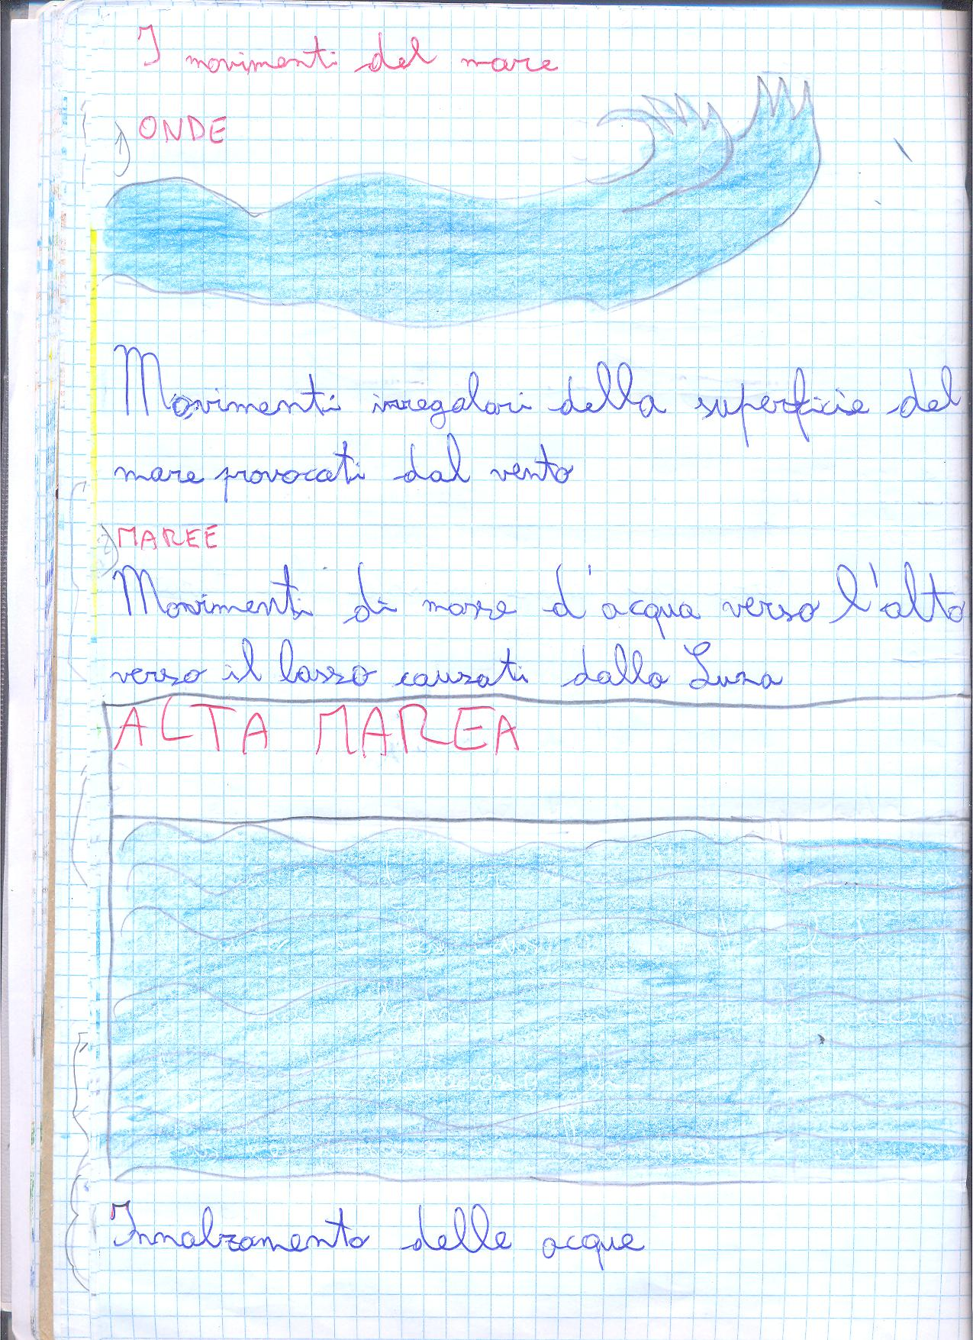

Slide 26
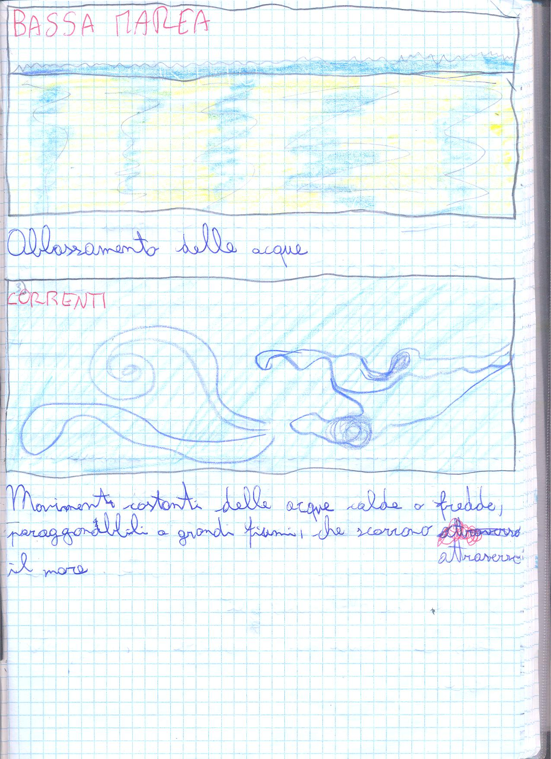

Slide 27
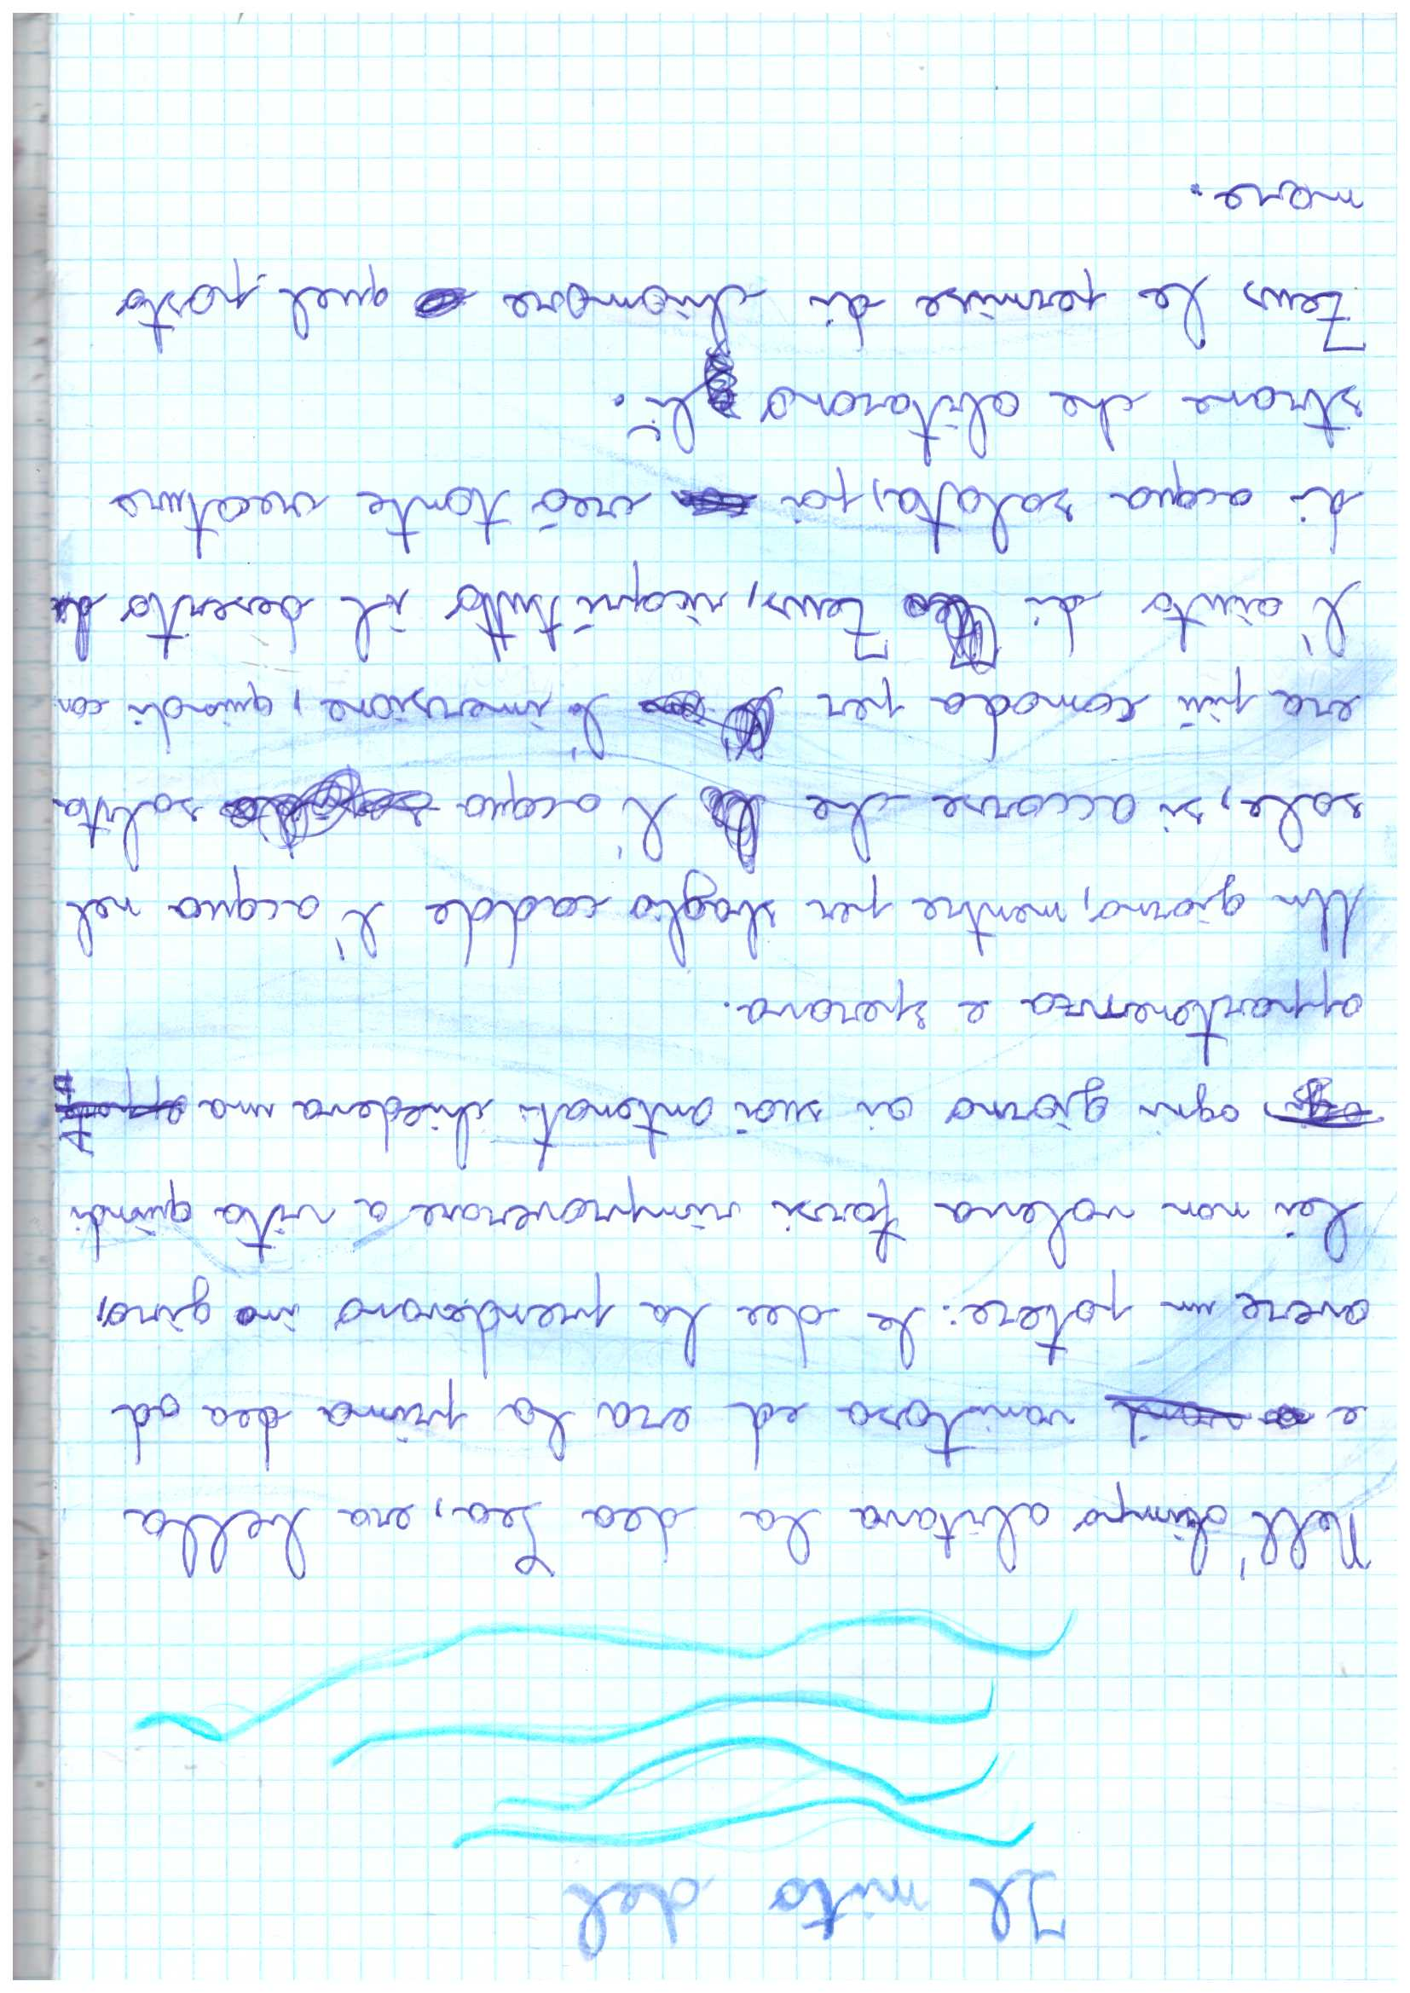
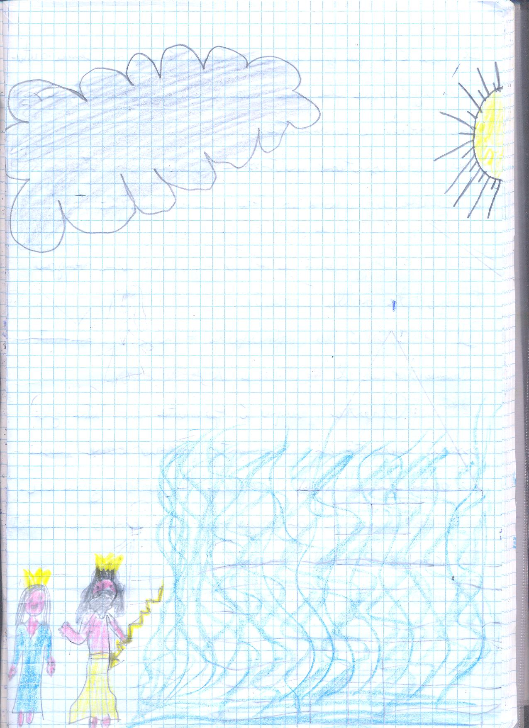

Slide 28
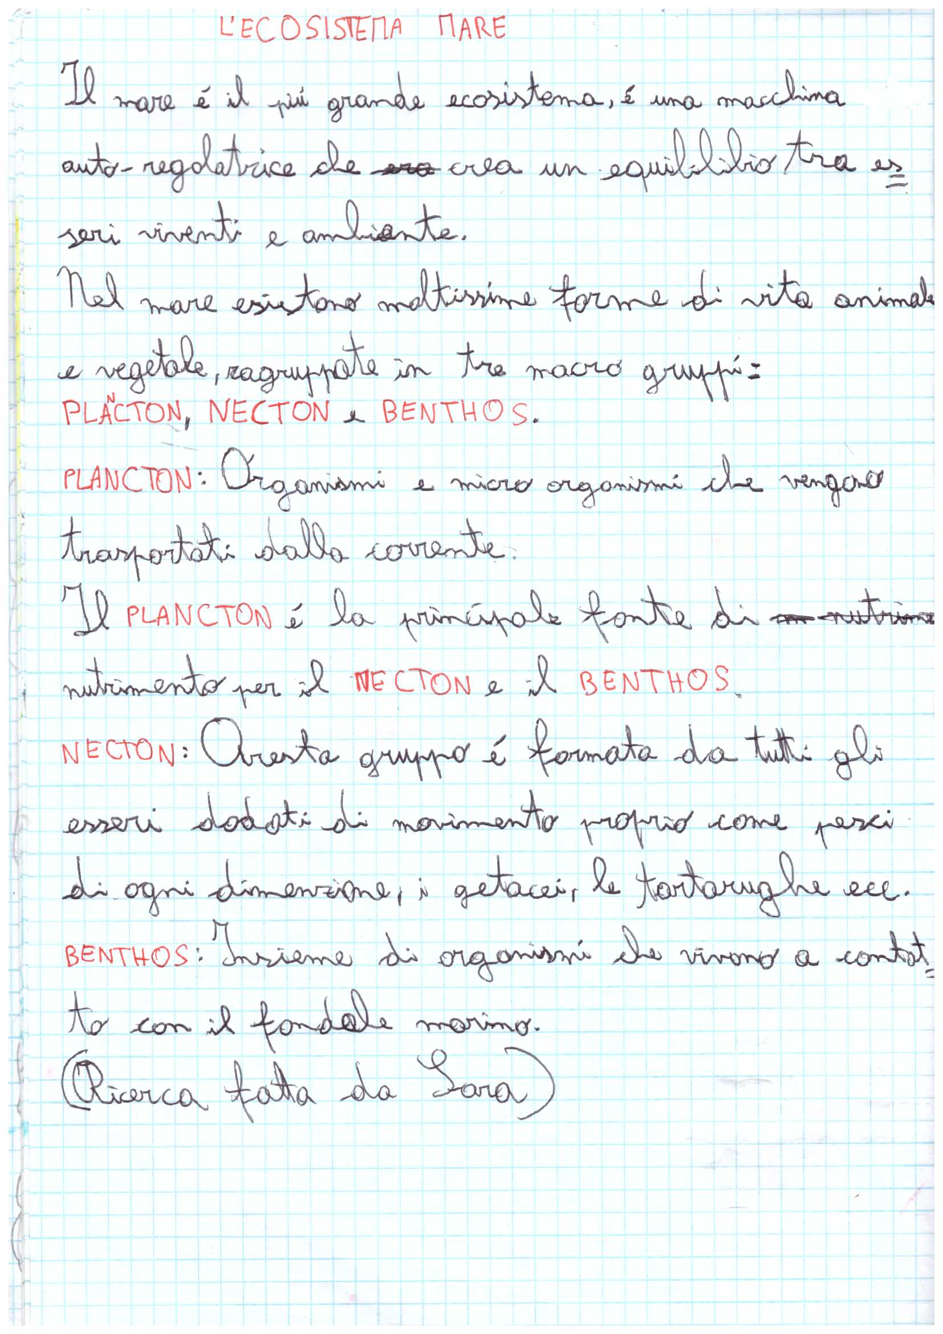

Slide 29
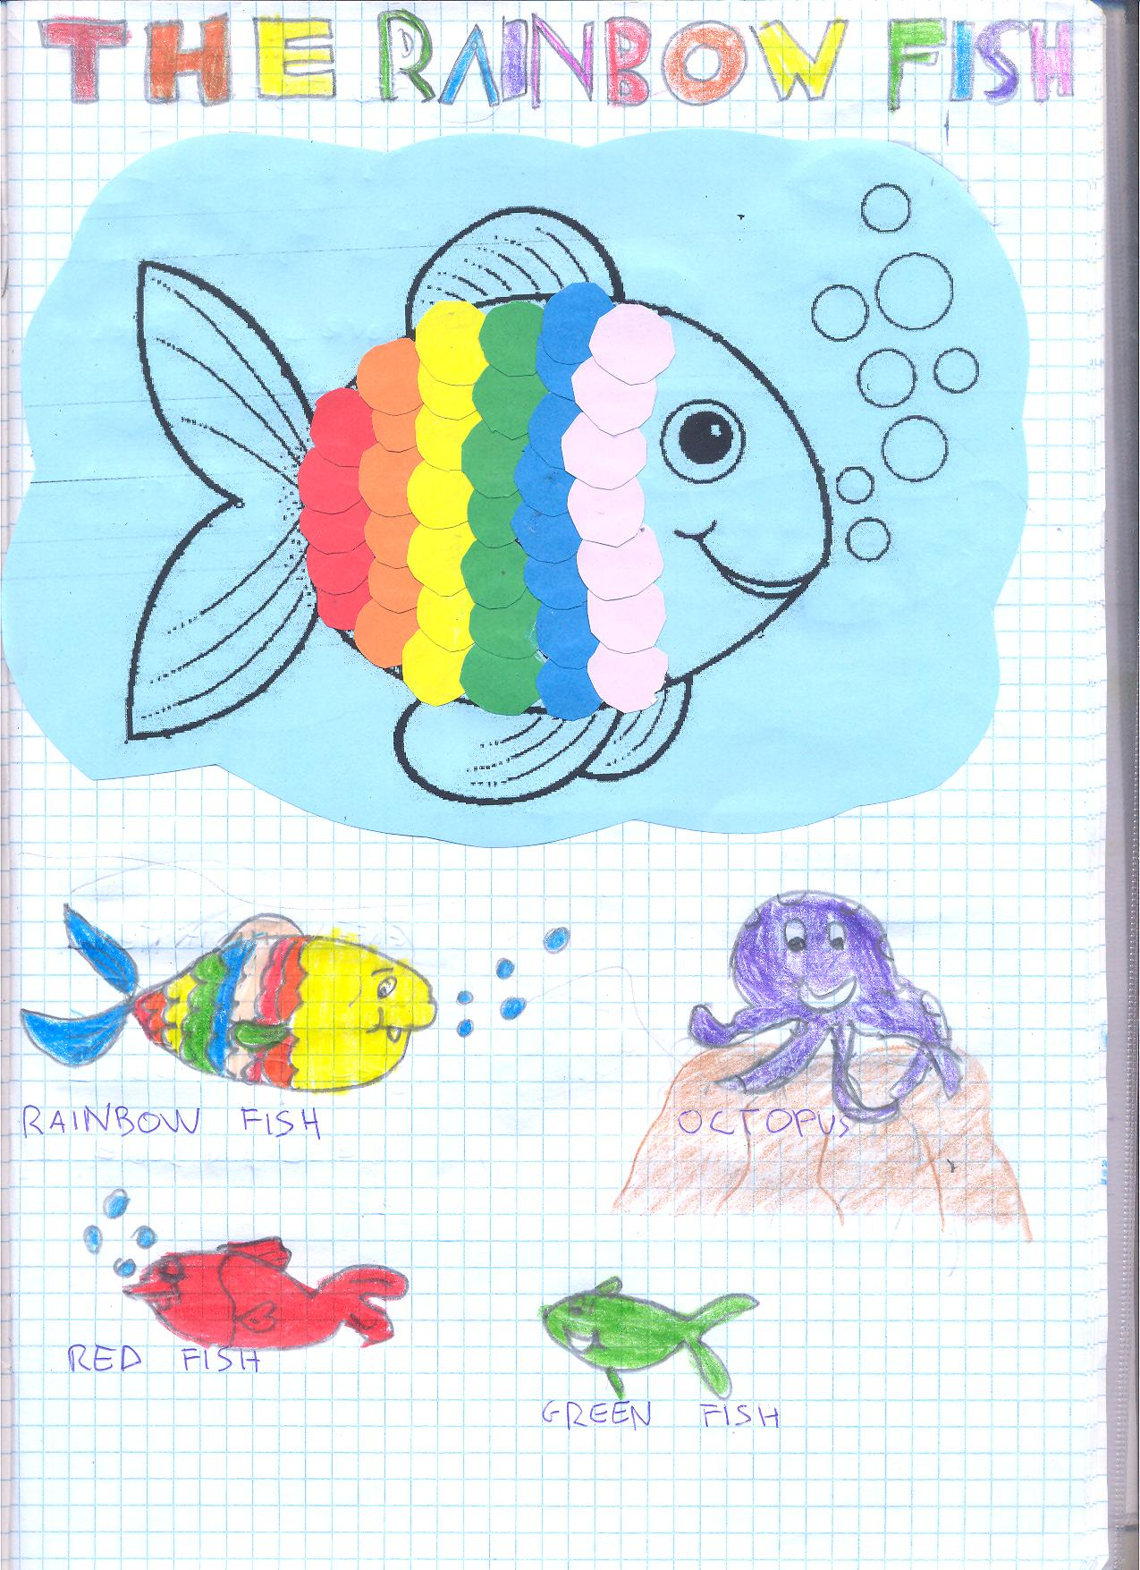
RED FISH: Hello, Rainbow Fish!
I’m Red Fish! Please, can I have
a yellow scale?
RAINBOW FISH: No! Go away!
GREEN FISH: Hello Rainbow
Fish! I’m Green Fish! Can I have
a pink scale , please?

Slide 30
RAINBOW FISH: No! Go away!
Octopus: No! Go Away!
RAINBOW FISH: I’m Rainbow Fish! Come and play with me!
RAINBOW FISH: I feel alone!

Slide 31
So gives a yellow scale to Red Fish and a pink scale to Green Fish.
Now they are all friends!
RAINBOW FISH

Slide 32
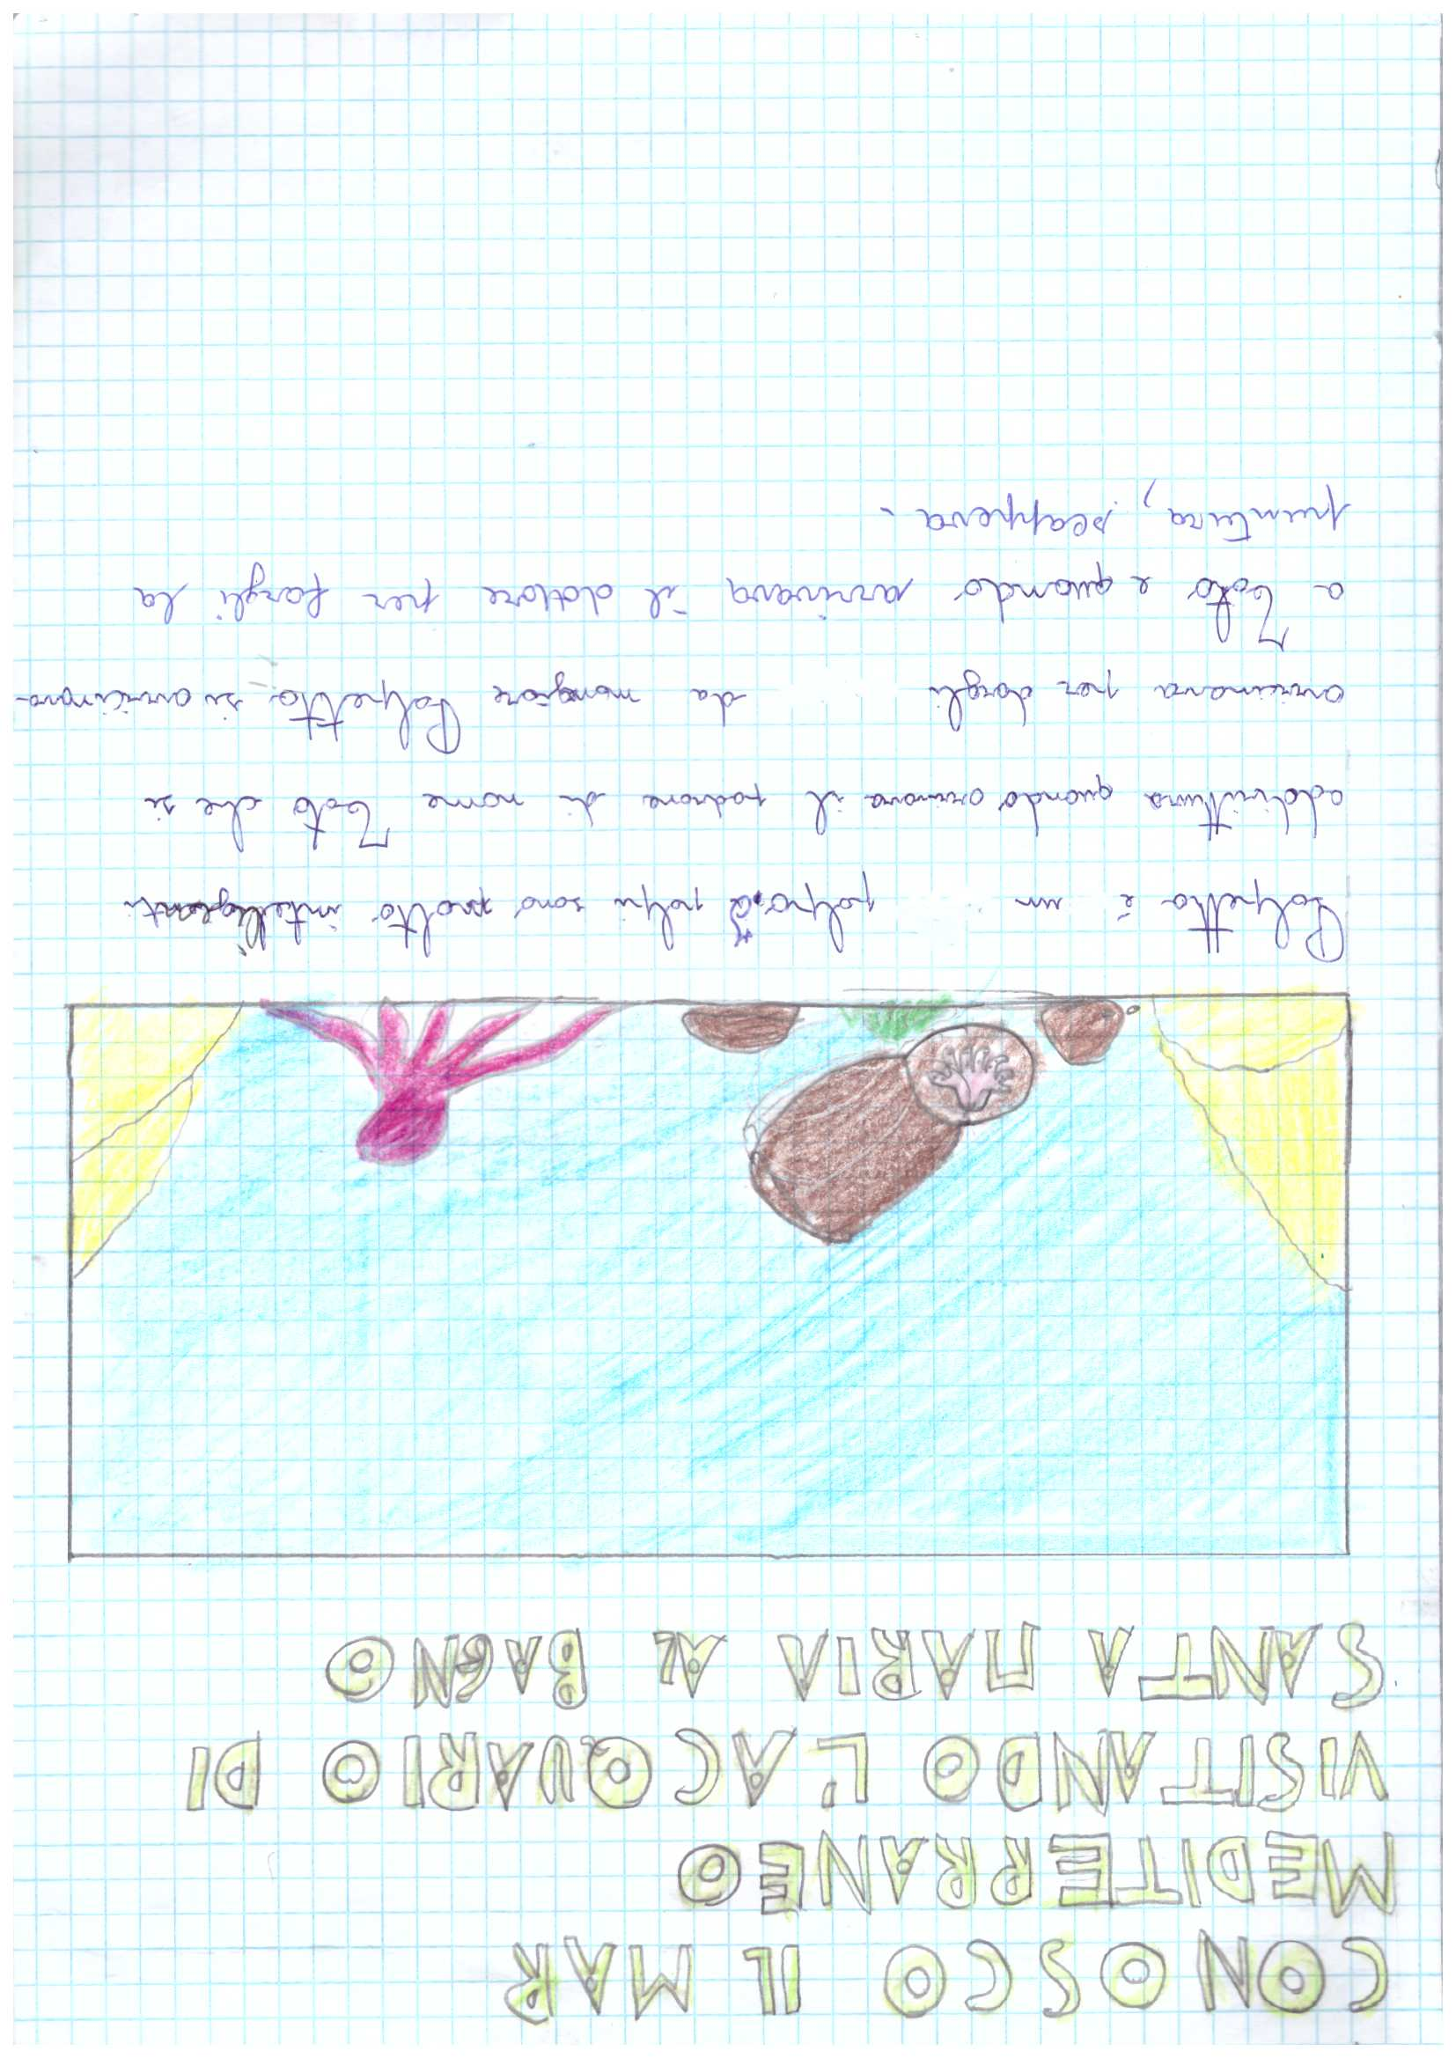
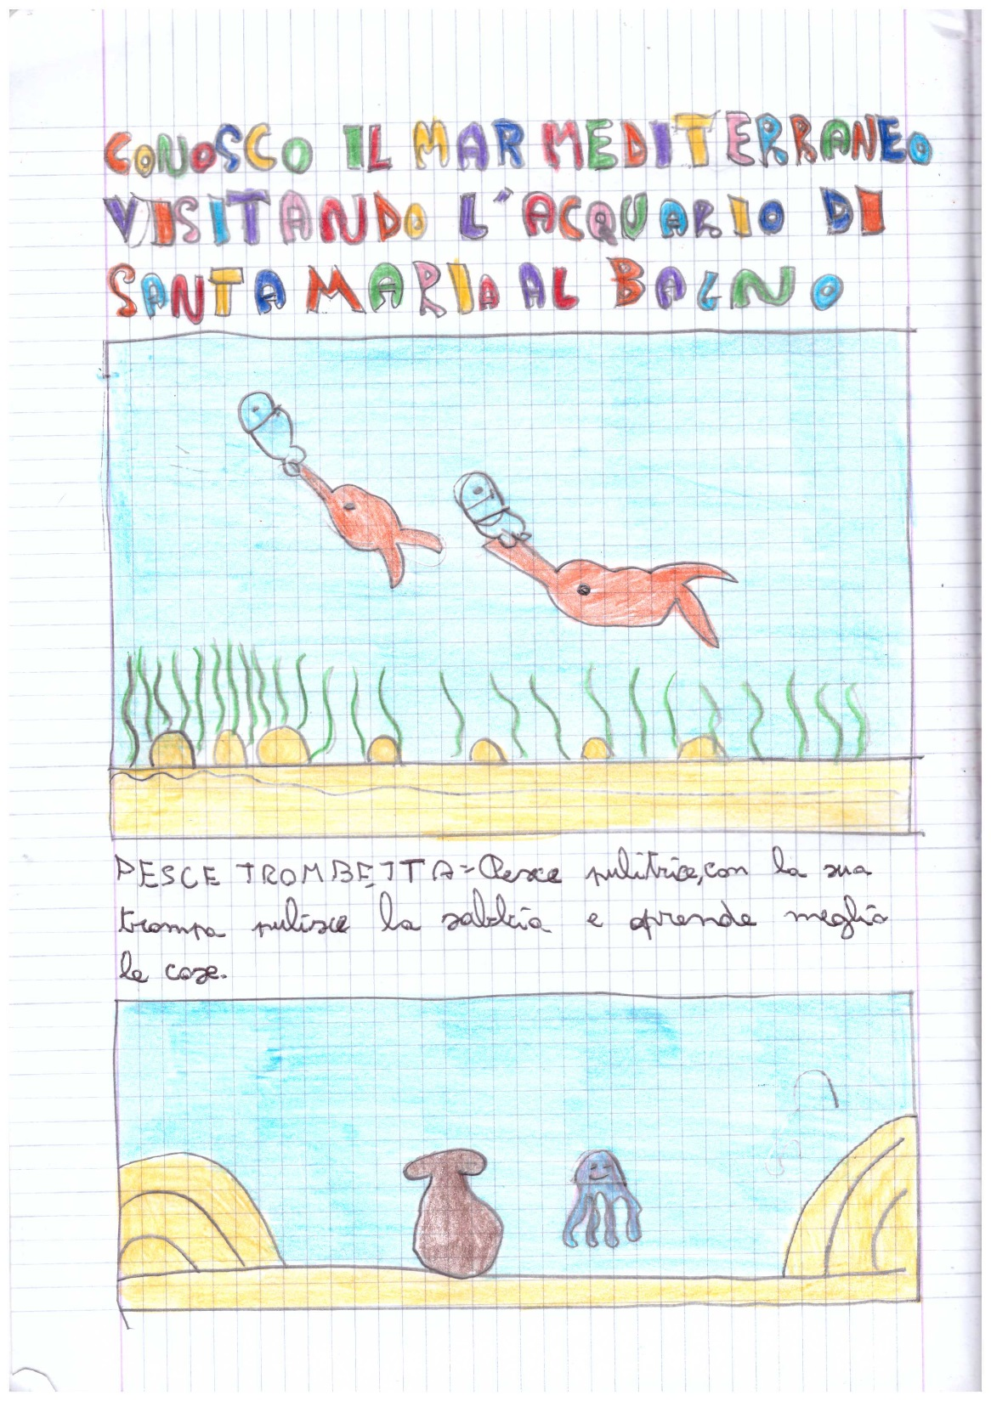

Slide 33
ANGEL! LOOK OUT!
Angel and his grandpa live on the Great Barrier Reef in Australia.
Grandpa is tired and goes to sleep!

Slide 34
Angel goes to play with Turtle.
They meet a dangerous octopus...
… and a dangerous fish!

Slide 35
Angel gives Turtle a present … but it is a
dangerous cone shell!
They are lost …… but Doug takes them home!
Angel is tired, but they can’t rest … there’s a
dangerous sea snake.
Grandpa is happy because Angel is
a very good fish!
They meet a jellyfish, so they swim away!

Slide 36
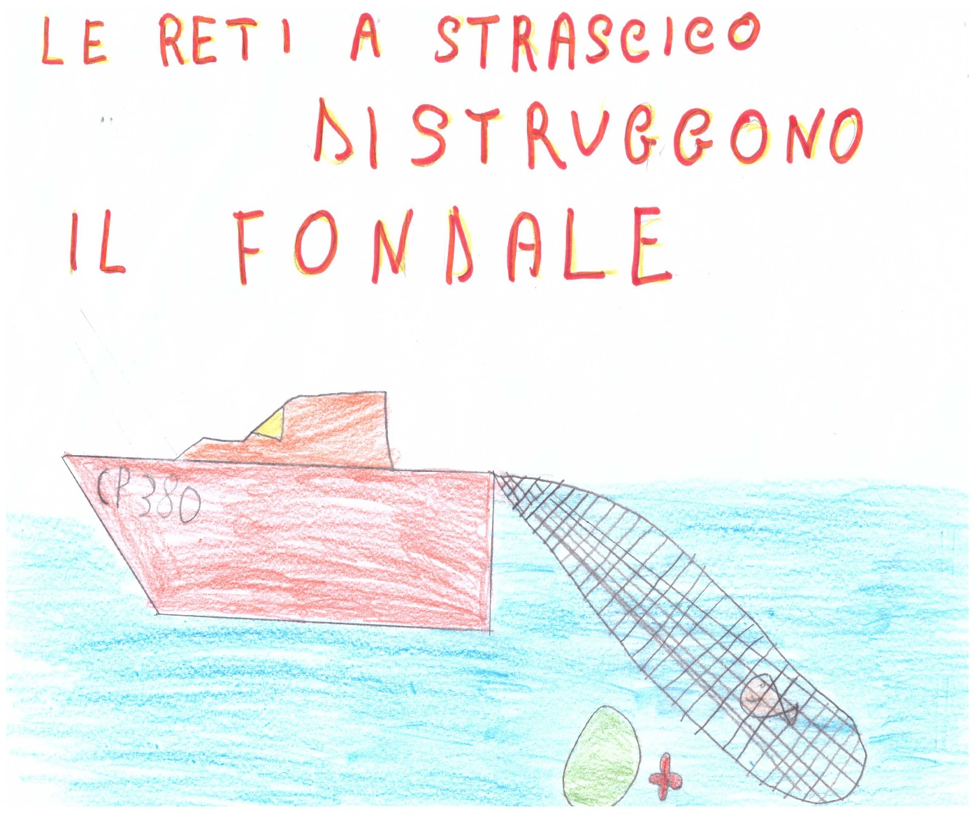
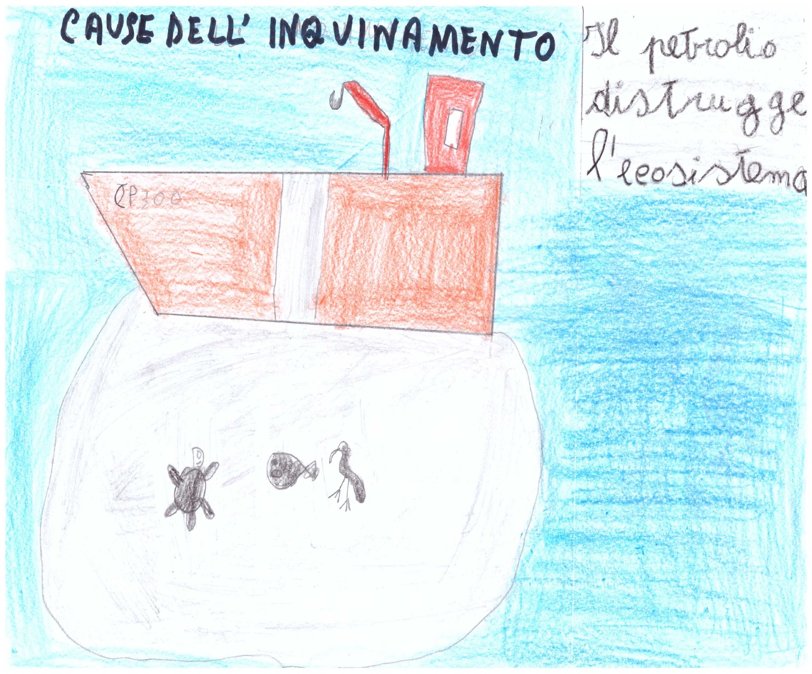
Il problema dell’inquinamento

Slide 37
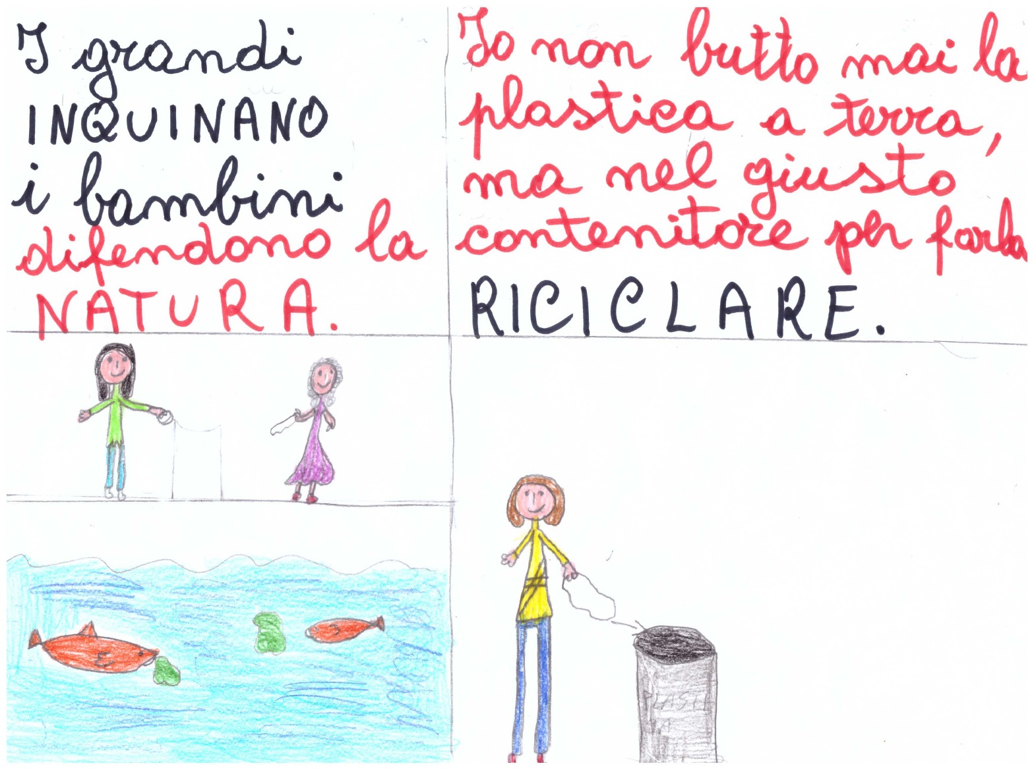
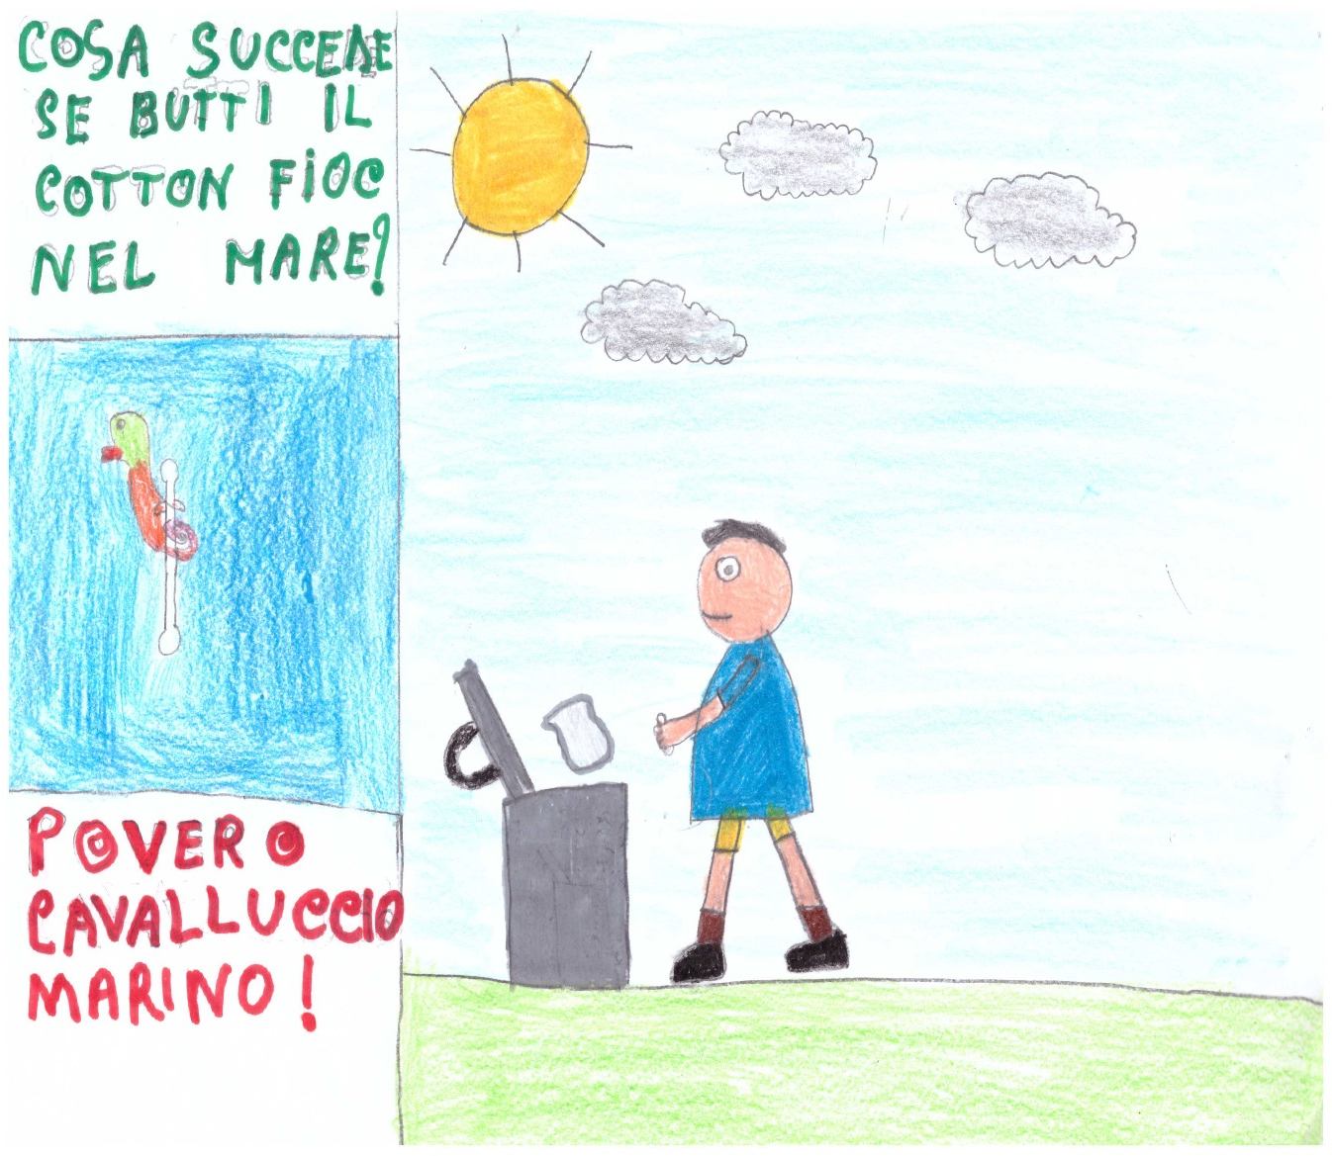

Slide 38
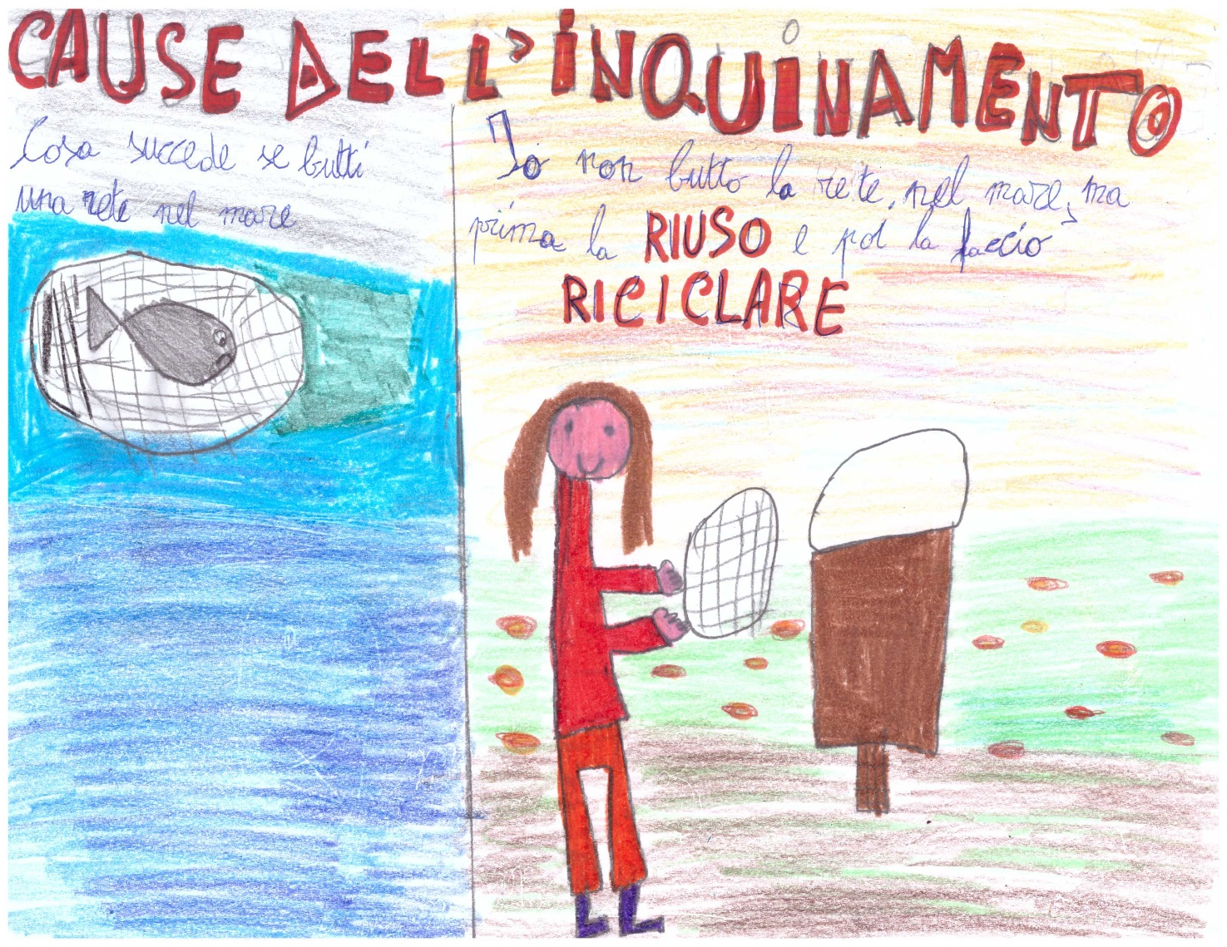
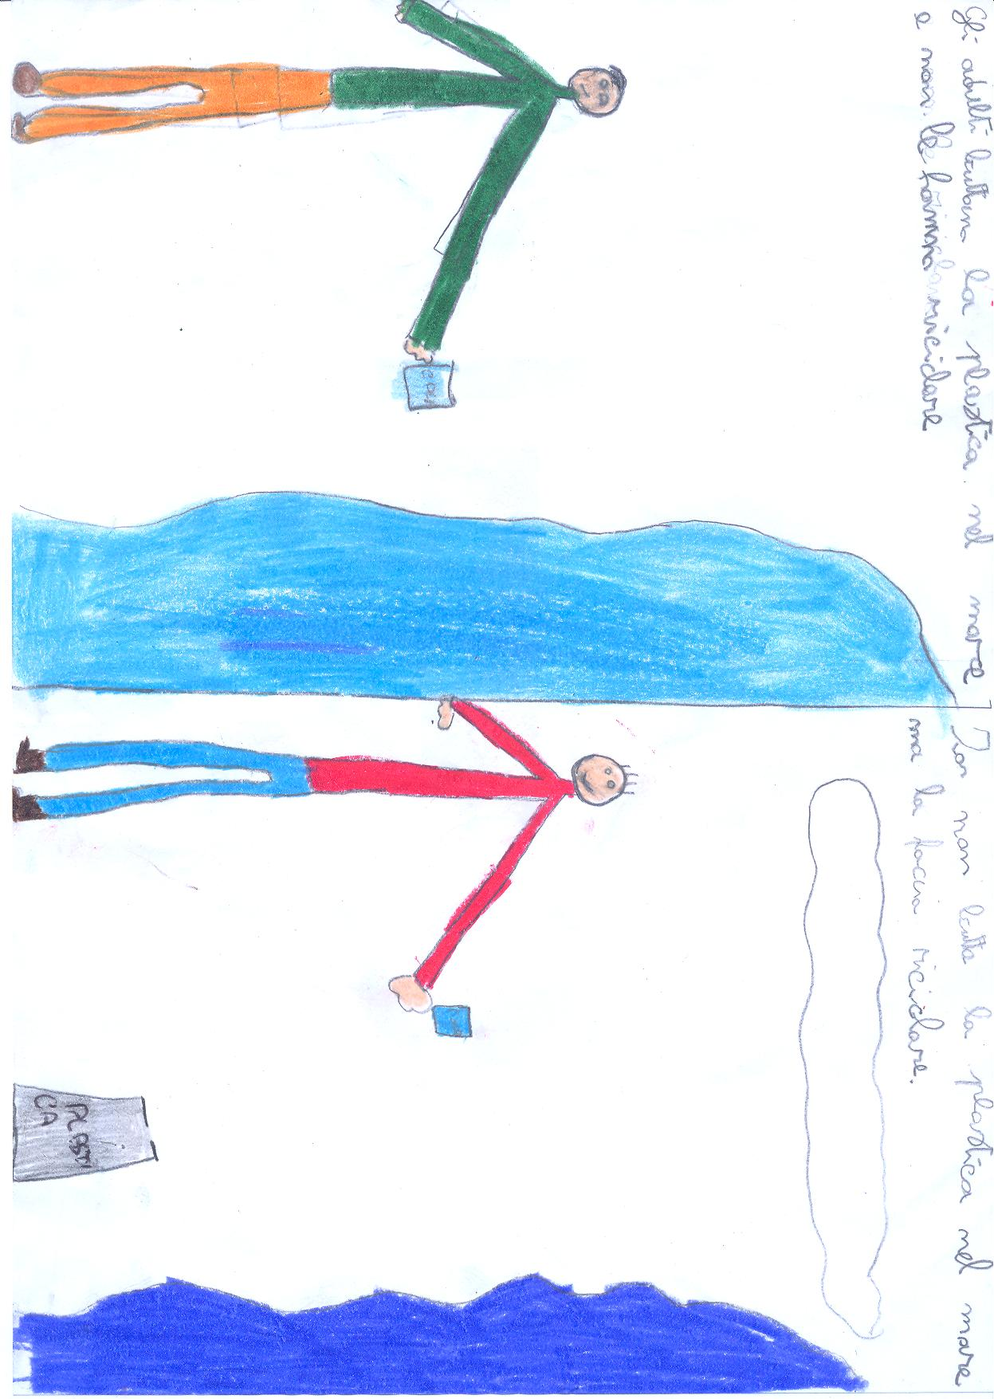

Slide 39
